Slide 1


Zero Trust Hardware Access
Use Case Portfolio
A practical guide for applying hardware-level trust across enterprise, branch, OT, healthcare, datacenter, and supply-chain environments.
Discover • Verify • Validate • Enforce
SEPIO | Zero Trust Hardware Access
01

Slide 2
The hardware blind spot
Most security controls trust what a device says it is. Attackers exploit that assumption.
Declared identity
Observed behavior
Physical truth
MAC, IP, hostname, agent status, certificate, serial number
Traffic patterns, endpoint telemetry, logs, anomalies
Electrical / physical-layer evidence and device-level fingerprint
Sepio starts where software trust stops.
SEPIO | Zero Trust Hardware Access
02

Slide 3

What Zero Trust Hardware Access means
A model for validating physical device identity before trust is granted.
Discover
Verify
Validate
Enforce
Find every connected asset, including unknown, dormant, unmanaged, or misclassified devices.
Establish true identity using AssetDNA and physical-layer evidence, not declared identity.
Compare actual identity against expected role, location, ownership, and policy.
Enable trust decisions, alerting, remediation guidance, and orchestration through existing tools.
SEPIO | Zero Trust Hardware Access
03

Slide 4
Use case coverage map
The same hardware-trust foundation applies across multiple risk categories.
Supply chain
Workforce & insider
Network & branch
Counterfeit / tampered devices
OEM masquerade
Pre-installed hardware implants
Internal abusers
Unauthorized peripherals
Policy bypass
Rogue devices
Shadow IT
Unmanaged switches / bridges
Endpoint & USB
Critical environments
Operations & governance
BadUSB / HID emulation
IP-KVM / remote access
Agentless devices
OT/ICS
Healthcare IoMT
ATM / POS / kiosks
M&A inventory
Compliance evidence
Asset lifecycle validation
SEPIO | Zero Trust Hardware Access
04

Slide 5
1. Hardware supply-chain attacks
Tampered device introduced before deployment • Golden image looks clean while hardware is compromised • Device passes procurement paperwork but fails physical trust
Threat pattern
Why conventional tools miss it
How Sepio applies ZTHA
Business outcome
• Tampered device introduced before deployment
• Golden image looks clean while hardware is compromised
• Device passes procurement paperwork but fails physical trust
• EDR sees OS state, not hardware origin
• NAC often trusts MAC/OUI or certificates
• CMDB records can inherit supplier claims
• Fingerprint device using AssetDNA
• Compare physical identity to approved baseline
• Flag mismatch before trust is granted
• Reduce counterfeit and implant risk
• Protect regulated procurement chains
• Create evidence for supplier assurance
SEPIO | Zero Trust Hardware Access
05

Slide 6
2. Counterfeit or OEM-masquerading devices
Device claims a trusted brand or model • MAC address and certificates look legitimate • Hidden OEM lineage creates Section 889-style risk
Threat pattern
Why conventional tools miss it
How Sepio applies ZTHA
Business outcome
• Device claims a trusted brand or model
• MAC address and certificates look legitimate
• Hidden OEM lineage creates Section 889-style risk
• Declared attributes can be cloned or spoofed
• Inventory tools normalize by vendor claims
• Traffic may appear normal
• Validate physical identity independent of labels
• Expose device identity conflicts
• Correlate identity with policy and asset owner
• Find banned or risky equipment
• Reduce compliance exposure
• Avoid trust based on paperwork alone
SEPIO | Zero Trust Hardware Access
06

Slide 7
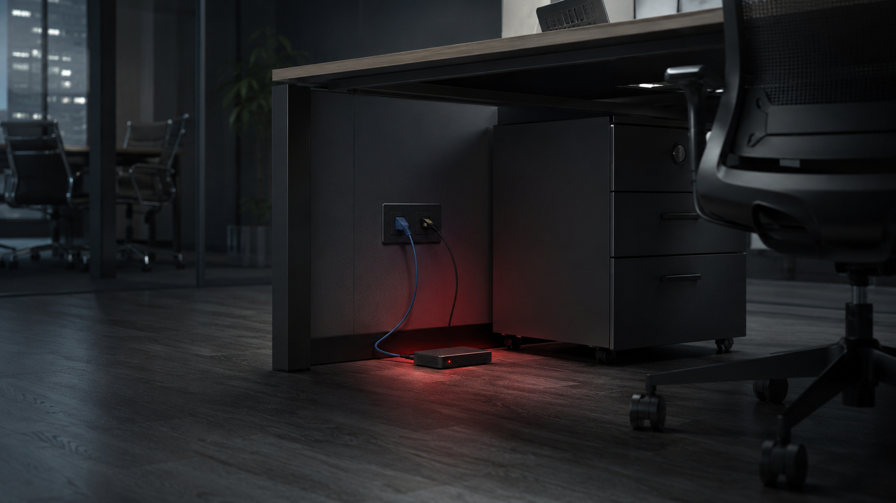
3. Rogue network devices
Unauthorized device connected to live port • Small implant, access point, bridge, or mini switch added • Rogue device lives below the radar
Threat pattern
Why conventional tools miss it
How Sepio applies ZTHA
Business outcome
• Unauthorized device connected to live port
• Small implant, access point, bridge, or mini switch added
• Rogue device lives below the radar
• No agent to detect
• May not generate suspicious traffic initially
• MAC/IP can be changed instantly
• Discover at infrastructure edge
• Locate exact switch/AP/port context
• Alert on unknown or policy-violating hardware
• Accelerate containment
• Give IT the exact physical location
• Reduce dwell time for hardware attacks
SEPIO | Zero Trust Hardware Access
07

Slide 8

4. Shadow IT and unmanaged assets
Teams add devices outside IT process • Lab equipment, printers, cameras, IoT, or test gear remains unmanaged • Inventory becomes incomplete and stale
Threat pattern
Why conventional tools miss it
How Sepio applies ZTHA
Business outcome
• Teams add devices outside IT process
• Lab equipment, printers, cameras, IoT, or test gear remains unmanaged
• Inventory becomes incomplete and stale
• CMDB depends on manual onboarding
• EDR only covers supported endpoints
• Scanners miss dormant or segmented devices
• Continuously discover connected hardware
• Classify and tag assets at scale
• Validate location, ownership, and expected behavior
• Build authoritative inventory
• Reduce audit gaps
• Bring unmanaged assets into governance
SEPIO | Zero Trust Hardware Access
08

Slide 9

5. Internal abusers and policy bypass
Authorized user connects unauthorized hardware • Employee uses USB storage, rogue AP, or tethering device • Insider creates hidden path for exfiltration
Threat pattern
Why conventional tools miss it
How Sepio applies ZTHA
Business outcome
• Authorized user connects unauthorized hardware
• Employee uses USB storage, rogue AP, or tethering device
• Insider creates hidden path for exfiltration
• User identity is trusted after login
• Peripheral events may lack context
• Intent may look like normal work
• Validate hardware attached to trusted hosts or ports
• Detect deviations from allowed device classes
• Map user/workstation/location for response
• Reduce insider risk
• Enforce least privilege at device layer
• Support investigations with physical evidence
SEPIO | Zero Trust Hardware Access
09

Slide 10
6. EDR/XDR coverage gaps
Devices exist without agents • Unsupported OS, guest device, IoT, printer, OT endpoint, or appliance • Attacker targets unmanaged assets
Threat pattern
Why conventional tools miss it
How Sepio applies ZTHA
Business outcome
• Devices exist without agents
• Unsupported OS, guest device, IoT, printer, OT endpoint, or appliance
• Attacker targets unmanaged assets
• EDR protects only where the agent exists
• XDR correlates signals after telemetry exists
• Agent deployment status does not equal asset truth
• Show every device without relying on agents
• Identify assets missing EDR coverage
• Feed findings into EDR/XDR and IT workflows
• Expand protection coverage
• Drive remediation and license expansion
• Prevent blind spots from becoming attack paths
SEPIO | Zero Trust Hardware Access
10

Slide 11
7. NAC bypass and identity spoofing
Device spoofs MAC/OUI or borrows credentials • Endpoint profile matches allowed device type • Attacker abuses allowlists
Threat pattern
Why conventional tools miss it
How Sepio applies ZTHA
Business outcome
• Device spoofs MAC/OUI or borrows credentials
• Endpoint profile matches allowed device type
• Attacker abuses allowlists
• NAC often relies on network identity and posture checks
• MAC and hostname are easy to spoof
• Credentials do not prove hardware authenticity
• Add physical-layer identity verification to access decisions
• Detect device identity mismatch
• Trigger NAC/SOAR actions when trust fails
• Strengthen Zero Trust access
• Reduce spoofing risk
• Make NAC decisions hardware-aware
SEPIO | Zero Trust Hardware Access
11

Slide 12
8. BadUSB / Rubber Ducky / HID emulation
Malicious USB acts like a keyboard or trusted peripheral • Payload executes through keystrokes • Device identity is intentionally deceptive
Threat pattern
Why conventional tools miss it
How Sepio applies ZTHA
Business outcome
• Malicious USB acts like a keyboard or trusted peripheral
• Payload executes through keystrokes
• Device identity is intentionally deceptive
• HID devices are often permitted
• Software may see a normal keyboard
• Behavior may happen too fast for manual response
• Classify USB peripherals by hardware identity
• Detect unexpected peripheral classes
• Support policies per user, host, location, and device type
• Reduce USB attack surface
• Prevent trusted-interface abuse
• Improve endpoint peripheral governance
SEPIO | Zero Trust Hardware Access
12

Slide 13
9. IP-KVM and remote-control hardware
External remote-access hardware is attached to a server or workstation • Device emulates keyboard/mouse/video path • Bypasses software remote-access controls
Threat pattern
Why conventional tools miss it
How Sepio applies ZTHA
Business outcome
• External remote-access hardware is attached to a server or workstation
• Device emulates keyboard/mouse/video path
• Bypasses software remote-access controls
• EDR may see legitimate keyboard/mouse input
• Network tools may see a generic device
• Physical presence is the attack channel
• Discover and classify connected remote-access hardware
• Validate whether such devices are authorized
• Locate where they are connected for removal
• Prevent hidden remote-access paths
• Protect admin workstations and servers
• Strengthen privileged access assurance
SEPIO | Zero Trust Hardware Access
13

Slide 14
10. Unmanaged switches, bridges, and rogue APs
Mini switch or wireless bridge creates an unauthorized segment • Multiple devices hide behind one approved connection • Network topology becomes inaccurate
Threat pattern
Why conventional tools miss it
How Sepio applies ZTHA
Business outcome
• Mini switch or wireless bridge creates an unauthorized segment
• Multiple devices hide behind one approved connection
• Network topology becomes inaccurate
• Traffic tools see aggregated or indirect activity
• CMDB has no record of physical topology change
• Basic NAC sees a known upstream device
• Detect physical topology and infrastructure changes
• Surface unexpected downstream devices
• Map edge-port location and device relationships
• Eliminate hidden network paths
• Restore accurate topology
• Reduce lateral movement opportunities
SEPIO | Zero Trust Hardware Access
14

Slide 15
11. ATM, POS, kiosk, and branch protection
Black-box device added to ATM/POS network • Peripheral tampering or rogue connectivity in branch environment • Remote site has limited technical staff
Threat pattern
Why conventional tools miss it
How Sepio applies ZTHA
Business outcome
• Black-box device added to ATM/POS network
• Peripheral tampering or rogue connectivity in branch environment
• Remote site has limited technical staff
• Branch devices are distributed and heterogeneous
• Traffic inspection is hard and costly at scale
• Local response may be slow
• Provide trafficless hardware discovery
• Locate device to exact branch/port context
• Enable centralized policy and response workflows
• Reduce fraud and jackpotting exposure
• Improve branch security operations
• Protect revenue-generating endpoints
SEPIO | Zero Trust Hardware Access
15

Slide 16
12. OT/ICS and manufacturing environments
Unapproved engineering workstation, converter, PLC accessory, or IIoT device • Legacy OS and fragile operations cannot tolerate scanning • Unauthorized hardware disrupts safety and uptime
Threat pattern
Why conventional tools miss it
How Sepio applies ZTHA
Business outcome
• Unapproved engineering workstation, converter, PLC accessory, or IIoT device
• Legacy OS and fragile operations cannot tolerate scanning
• Unauthorized hardware disrupts safety and uptime
• Active scans can be risky
• Agents are often impossible
• Traffic visibility alone does not validate hardware identity
• Discover without traffic inspection or active endpoint scanning
• Classify assets across IT/OT boundaries
• Validate device role and location against policy
• Improve OT visibility without operational disruption
• Support segmentation and incident response
• Reduce unauthorized hardware risk
SEPIO | Zero Trust Hardware Access
16

Slide 17
13. Healthcare IoMT and clinical device sprawl
Medical devices, carts, cameras, and peripherals proliferate • Shared clinical spaces introduce unmanaged assets • Patient safety and privacy depend on accurate inventory
Threat pattern
Why conventional tools miss it
How Sepio applies ZTHA
Business outcome
• Medical devices, carts, cameras, and peripherals proliferate
• Shared clinical spaces introduce unmanaged assets
• Patient safety and privacy depend on accurate inventory
• Agents rarely supported on IoMT
• Clinical devices move locations
• Traditional scans can create operational concerns
• Continuously identify and locate hardware assets
• Maintain context even when devices move
• Separate trusted clinical assets from unknown hardware
• Improve IoMT governance
• Support compliance and incident readiness
• Reduce risk without disrupting care
SEPIO | Zero Trust Hardware Access
17

Slide 18
14. Datacenter and cloud-edge infrastructure
Unauthorized console, management, network, or test device appears in a high-value environment • Misplaced hardware creates hidden access path • Scale makes manual audits impractical
Threat pattern
Why conventional tools miss it
How Sepio applies ZTHA
Business outcome
• Unauthorized console, management, network, or test device appears in a high-value environment
• Misplaced hardware creates hidden access path
• Scale makes manual audits impractical
• Datacenter inventory often lags physical reality
• Management ports and peripherals are overlooked
• Telemetry depends on installed tools
• Create hardware-level inventory across racks, switches, and hosts
• Detect anomalous connections at the physical edge
• Integrate with CMDB/SIEM/SOAR for workflows
• Protect crown-jewel infrastructure
• Accelerate audits and change validation
• Reduce unauthorized access paths
SEPIO | Zero Trust Hardware Access
18

Slide 19
15. Site consolidation, and unknown environments
Consolidated networks contain unknown devices and legacy assets • Security teams inherit unmanaged hardware risk • Integration creates fast-moving blind spots
Threat pattern
Why conventional tools miss it
How Sepio applies ZTHA
Business outcome
• Consolidated networks contain unknown devices and legacy assets
• Security teams inherit unmanaged hardware risk
• Integration creates fast-moving blind spots
• CMDBs are incomplete or incompatible
• Agents take time to deploy
• Discovery projects are manual and fragmented
• Rapidly establish baseline hardware inventory
• Identify unmanaged, risky, or policy-violating devices
• Prioritize remediation by location and device class
• Compress due-diligence timelines
• Reduce integration risk
• Create a single hardware truth layer
SEPIO | Zero Trust Hardware Access
19

Slide 20
16. Compliance evidence and audit readiness
Auditors ask for proof of asset control, not just policy statements • Unknown hardware undermines security attestations • Regulations require demonstrable risk management
Threat pattern
Why conventional tools miss it
How Sepio applies ZTHA
Business outcome
• Auditors ask for proof of asset control, not just policy statements
• Unknown hardware undermines security attestations
• Regulations require demonstrable risk management
• Static inventory snapshots age quickly
• Manual evidence collection is expensive
• Logs rarely prove physical device authenticity
• Provide continuous inventory and policy evidence
• Show location, identity, and trust status
• Support compliance mapping through integrations
• Strengthen audit defensibility
• Reduce manual evidence collection
• Turn hardware visibility into governance
SEPIO | Zero Trust Hardware Access
20

Slide 21
From detection to action
ZTHA turns hardware identity into an operational workflow.
1
2
3
4
5
Detect
Locate
Validate
Respond
Learn
Unknown or mismatched device appears
Exact switch/AP/USB/host context
Compare to role, owner, location and policy
Alert, ticket, isolate port, invoke SOAR/NAC
Update baseline and policy for future enforcement
Operational principle: do not grant trust because a device looks familiar — grant trust because its hardware identity is verified and policy-valid.
SEPIO | Zero Trust Hardware Access
21

Slide 22
Use case prioritization matrix
Where Sepio typically creates fastest value.
High urgency / high visibility
Rogue devices, EDR gaps, NAC bypass, USB/HID, IP-KVM
High compliance exposure
Supply chain, counterfeit/OEM masquerade, Section 889-style risks, audit evidence
High operational scale
Shadow IT, Consolidated inventory, datacenter, branch/POS/ATM
High safety / continuity sensitivity
OT/ICS, healthcare IoMT, critical infrastructure
SEPIO | Zero Trust Hardware Access
22

Slide 23
Value by stakeholder
The same platform speaks to different priorities.
CISO / Risk
SecOps
IT / Network Ops
Compliance / Audit
Close hardware blind spots
Extend Zero Trust to device identity
Demonstrate governance
Prioritize unknown devices
Locate assets quickly
Trigger SIEM/SOAR workflows
Authoritative inventory
Less manual discovery
No taps/probes/traffic inspection
Continuous evidence
Traceable policy exceptions
Reduced audit scramble
SEPIO | Zero Trust Hardware Access
23

Slide 24
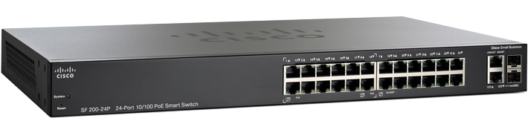
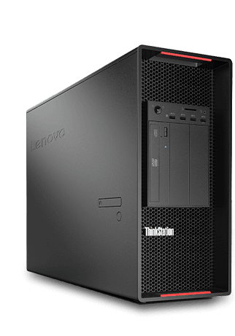
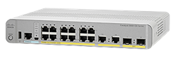
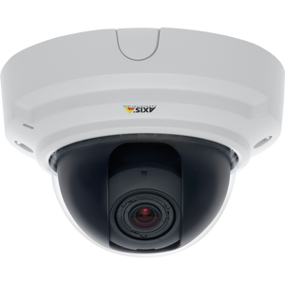
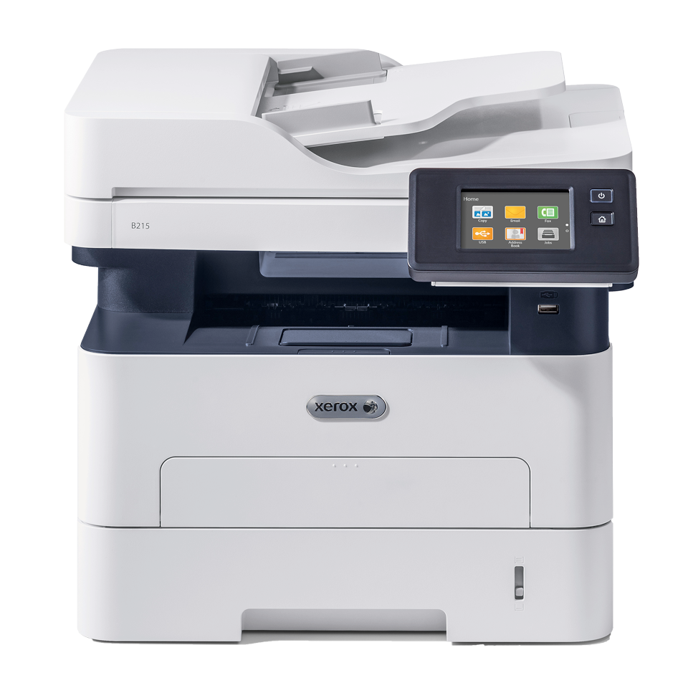
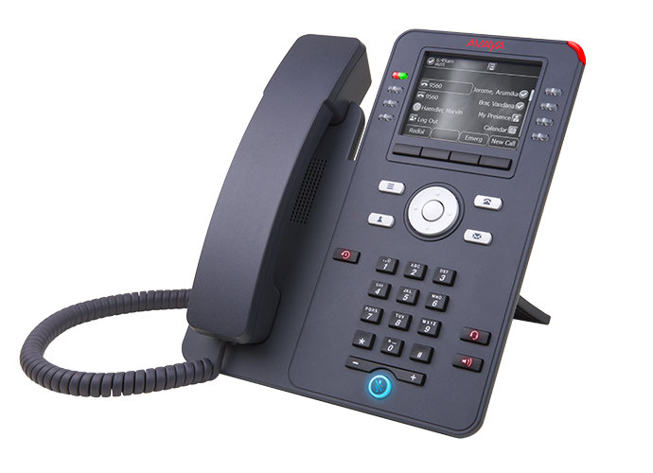

Security – AssetDNA (Fingerprint) Background
MAC Addresses seen on a switch port represents all the devices that are connected through that port
(but suffers from the effects of cascading… aging… etc.)
Port Fingerprints represents only the “first” device that is physically connected to the port
  Switch S1
  Switch S2
3
9
14
E
2
6
D
A
B
C
SEPIO | Zero Trust Hardware Access
25
Notes:
24

Slide 25
Security – AssetDNA (Fingerprint) Background
Port Fingerprint composition and behavior • Determined at link establishment • Influenced by switch chipset complexity
Port Fingerprint factors
FpData examples
The end device (physically connected on the port)
The switch chipset (“behind” the switch port)
The switch model
The negotiated link speed (due to port config, in some cases manual/forced)
Determined during link establishment — will not change until link goes down
More advanced chipsets produce richer fingerprint data and more variants
"FpData":"1140796dae02501101e14de100650000--------00012300000085140000----"
"FpData":"1140796dae02501101e14de100650000--------00010300000085140000----"
"FpData":"1000796D002062D00DE14DE100052001----3000----0300----8517----0617"
"FpData":"1000796D002062D00DE14DE100052005----3000----0300----8557----0617"
"FpData":"1000796D002062D00DE14DE100052009----3000----0300----8597----0617"
"FpData":"210079CD03625D7300010000006400000000300040012300000005040000021E"
"FpData":"210079CD03625D730001000000640000000030004001230000000504000000CB"
"FpData":"210079CD03625D73000100000064000000003000400123000000050400000213"
SEPIO | Zero Trust Hardware Access
26
Notes:
25

Slide 26
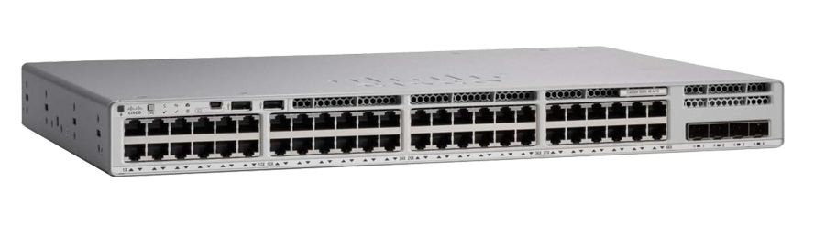
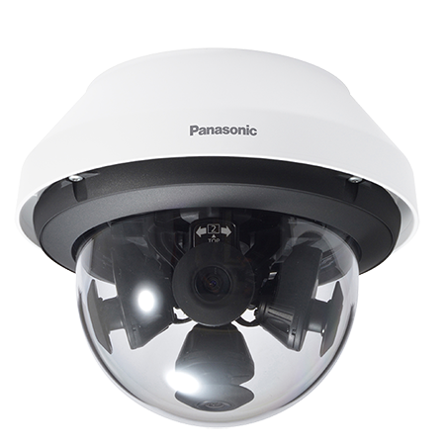
Security – AssetDNA (Fingerprint) Background
Most simple example – one Asset connected directly to the Supervised Switch:
MAC Address:
  Panasonic Camera
Fingerprint:
  Panasonic Camera (also function of the specific Chipset switch A)
  PoE:
  Potentially, if both the Camera supports (and configured to use) and Switch supports (and enabled) Port Fingerprints represents only the “first” device that is physically connected to the port
  Switch A
  Device 1
SEPIO | Zero Trust Hardware Access
27
Notes:
26

Slide 27

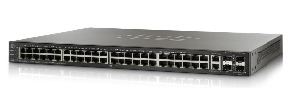
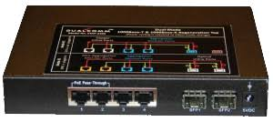
Security – AssetDNA (Fingerprint) Background
Using L1 Asset DNA to detect an attack:
And being able to detect:
  MiTM devices
  Spoofed devices
  “Partisan” unmanaged switches, WiFi bridges
  “Shadow IT”
Switch
MiTM or Active Tap
Device
A
B
From the switch point of view: Physical fingerprint of point A Logical entity of point B
SEPIO | Zero Trust Hardware Access
28
Notes:
27

Slide 28
Security – Attack Type 1 (Spoofing A)
Normal Situation:
A legitimate HP printer is connected to a port of a Sepio supervised switch.
Sepio sees MAC address and other logical parameters of the HP printer
Sepio sees the expected DNA of the HP printer
Sepio reports no risk
  Switch S1
7
A
SEPIO | Zero Trust Hardware Access
29
Notes:
28

Slide 29

Security – Attack Type 1 (Spoofing A)
Attack Situation
The HP printer is disconnected
A Dell Laptop is spoofing to be the HP printer (so uses a MAC address similar to the HP printer)
Sepio sees MAC address and other logical parameters of the HP printer
Sepio sees the Dell Laptop DNA that is different than the expected DNA of the HP printer
Sepio reports a DNA Anomaly risk
  Switch S1
7
A
SEPIO | Zero Trust Hardware Access
30
Notes:
29

Slide 30
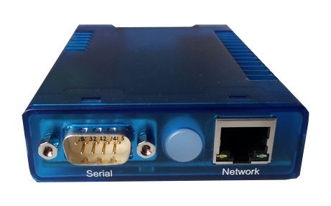
Security – Attack Type 1 (Spoofing A) Rare
Normal Situation:
A legitimate device that is unknown to Sepio (or seen only once) is connected to a port of a Sepio supervised switch
Sepio sees MAC address and other logical parameters of that never seen before device
Sepio sees the DNA of the never seen before device
Sepio reports “Rare device” risk.
  Switch S1
7
A
SEPIO | Zero Trust Hardware Access
31
Notes:
30

Slide 31
Security – Attack Type 1 (Spoofing A)
Attack Situation:
A trusted rule has been created for the legitimate device now disconnected
A Dell Laptop is spoofing to be the disconnected device (so uses a similar MAC address)
Sepio sees MAC address and other logical parameters of the device printer
Sepio sees Dell Laptop DNA conflict with a trusted rule.
Sepio reports a DNA Anomaly risk
  Switch S1
7
A
SEPIO | Zero Trust Hardware Access
32
Notes:
31

Slide 32
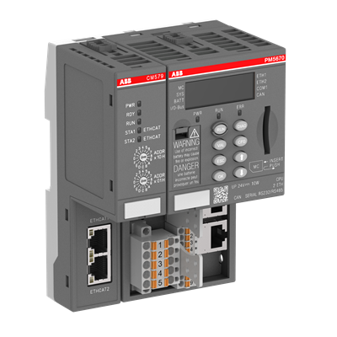
Security – Attack Type 2 (Spoofing B)
Normal Situation:
A legitimate ABB PLC is connected to a port of a Sepio supervised switch
Sepio sees MAC address and other logical parameters of the ABB PLC printer
Sepio sees the expected DNA of the ABB PLC printer
Sepio reports no risk
  Switch S1
3
B
SEPIO | Zero Trust Hardware Access
33
Notes:
32

Slide 33


Security – Attack Type 2 (Spoofing B)
Attack Situation:
The ABB PLC is manipulated to spoof to be a Samsung TV
Sepio sees MAC address and other logical parameters of the Samsung TV
Sepio sees the ABB PLC DNA that is different than the expected DNA of the Samsung TV
Sepio shows the Asset as a Samsung TV
Sepio reports a DNA Anomaly risk
  Switch S1
3
B
SEPIO | Zero Trust Hardware Access
34
Notes:
33

Slide 34
Security – Attack Type 2 (Spoofing B) Limitation
Normal Situation:
A legitimate ABB PLC is connected to a port of a Sepio supervised switch
Sepio sees MAC address and other logical parameters of the ABB PLC printer
Sepio sees the expected DNA of the ABB PLC printer
Sepio reports no risk
  Switch S1
3
B
SEPIO | Zero Trust Hardware Access
35
Notes:
34

Slide 35

Security – Attack Type 2 (Spoofing B) Limitation
Attack Situation:
The ABB PLC is manipulated an unknown MAC Address
Sepio sees MAC address and other logical parameters of an unknown device
Sepio shows the MAC Address that is in use, and shows the asset as “Other” and vendor as “Other”
Sepio sees the DNA of the “Other” device but has while analyzing has no trusted base for comparison
Sepio does not reports a DNA Anomaly risk
* Rare Asset risk indicator
  Switch S1
3
B
MAC Address
11:11:DE:AD:BE:EF
SEPIO | Zero Trust Hardware Access
36
Notes:
35

Slide 36
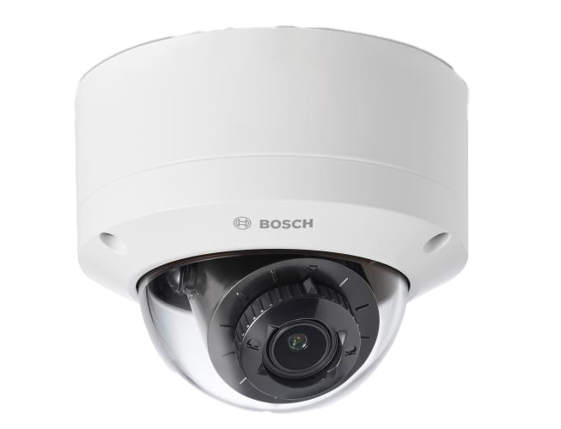

Security – Attack Type 3 (MitM)
Normal Situation:
A legitimate Bosch camera is connected to a port of a Sepio supervised switch
Sepio sees MAC address and other logical parameters of the Bosch camera
Sepio sees the expected DNA of the Bosch camera
Sepio reports no risk
  Switch S1
12
C
SEPIO | Zero Trust Hardware Access
37
Notes:
36

Slide 37
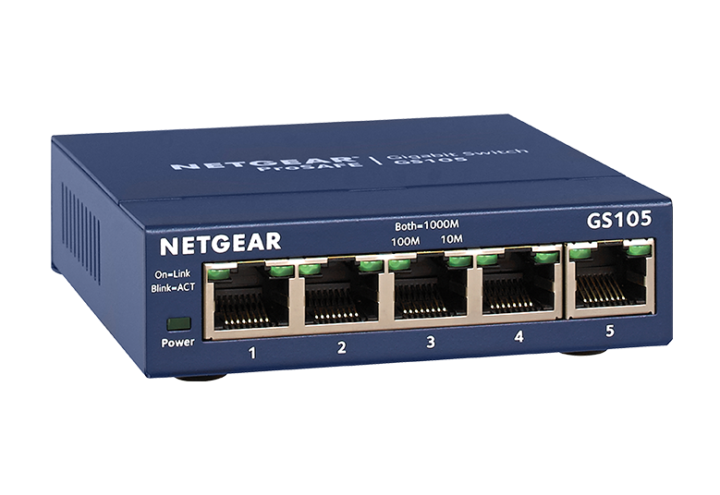
Security – Attack Type 3 (MitM)
Attack Situation:
A MitM device is added between the legitimate device and the supervised switch
A laptop (that is in receive only mode) is added to the MitM device
Using the laptop they can see the MAC address of the legitimate Bosch camera
The laptop will spoof the MAC address of the Bosch camera
The laptop can now send data to the network as if it came from the legitimate device
  Switch S1
12
C
SEPIO | Zero Trust Hardware Access
38
Notes:
37

Slide 38
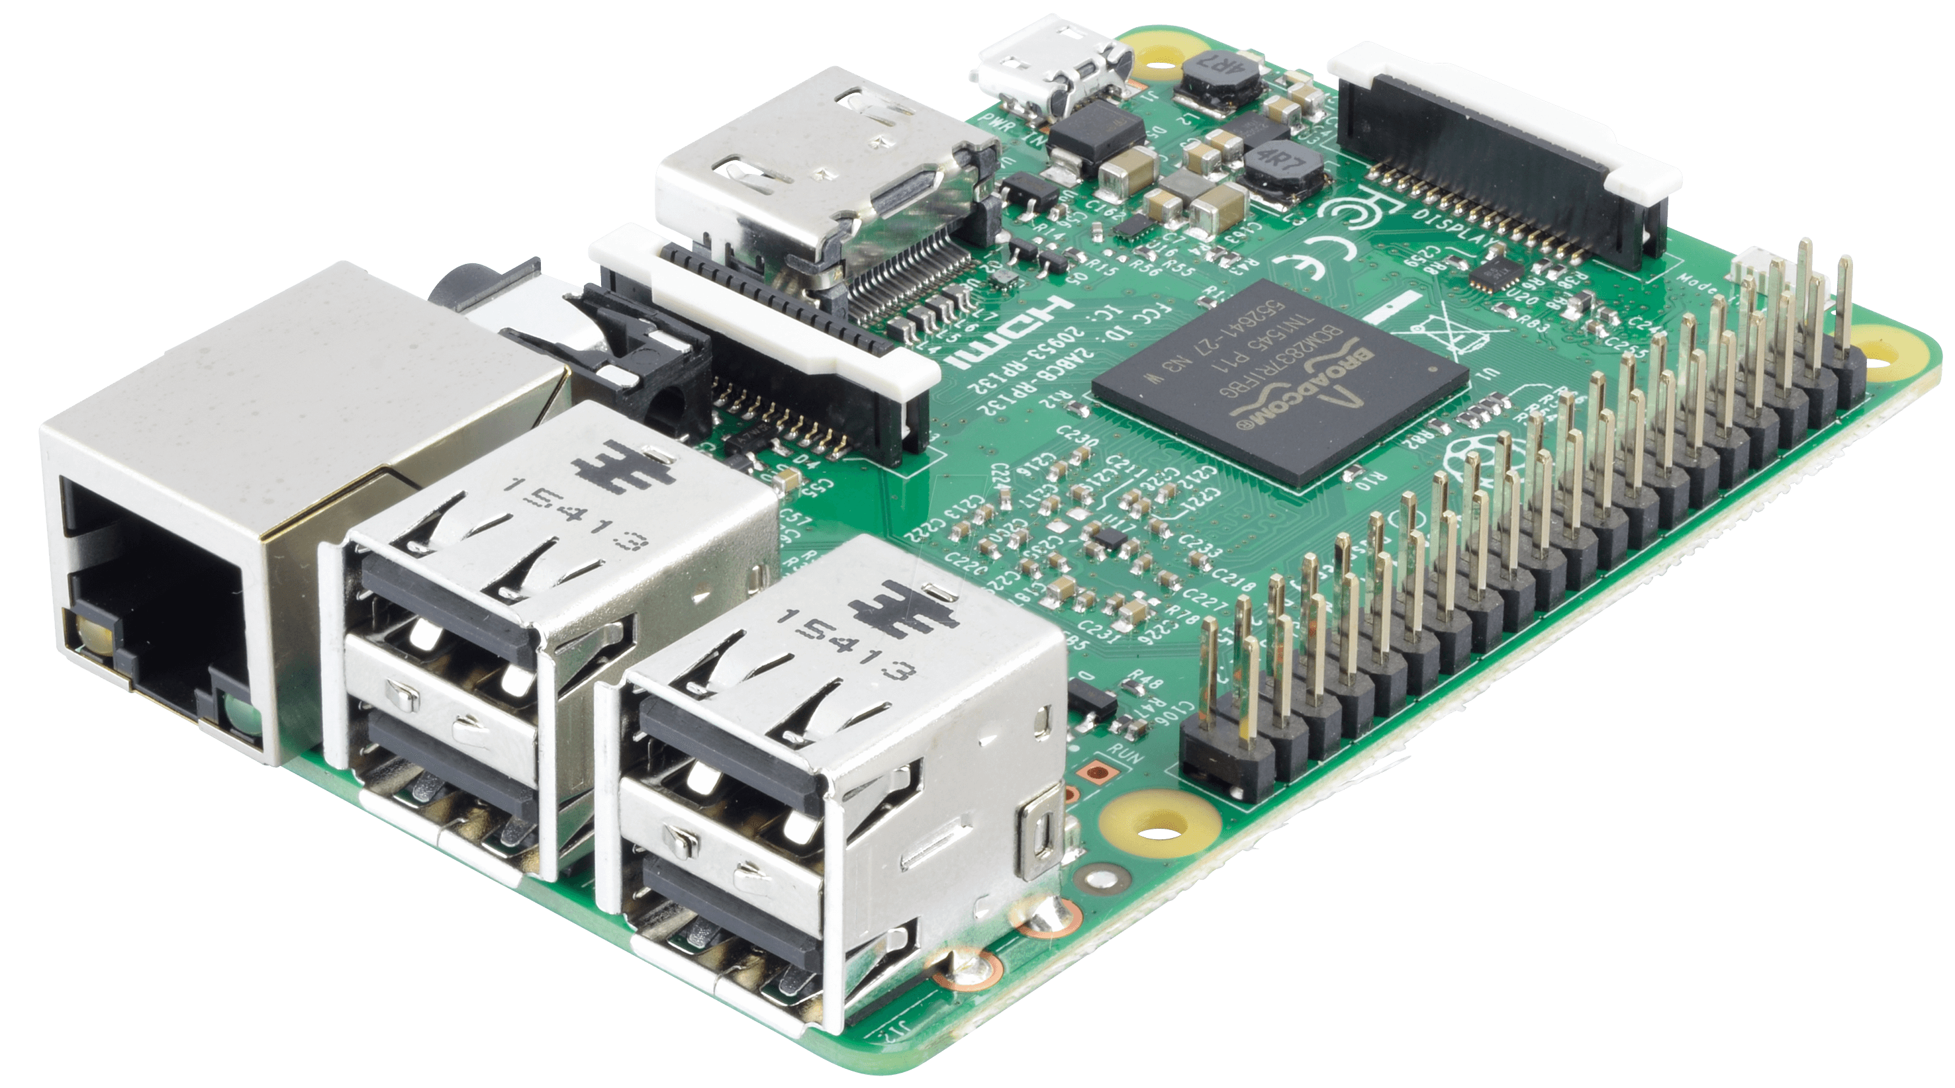
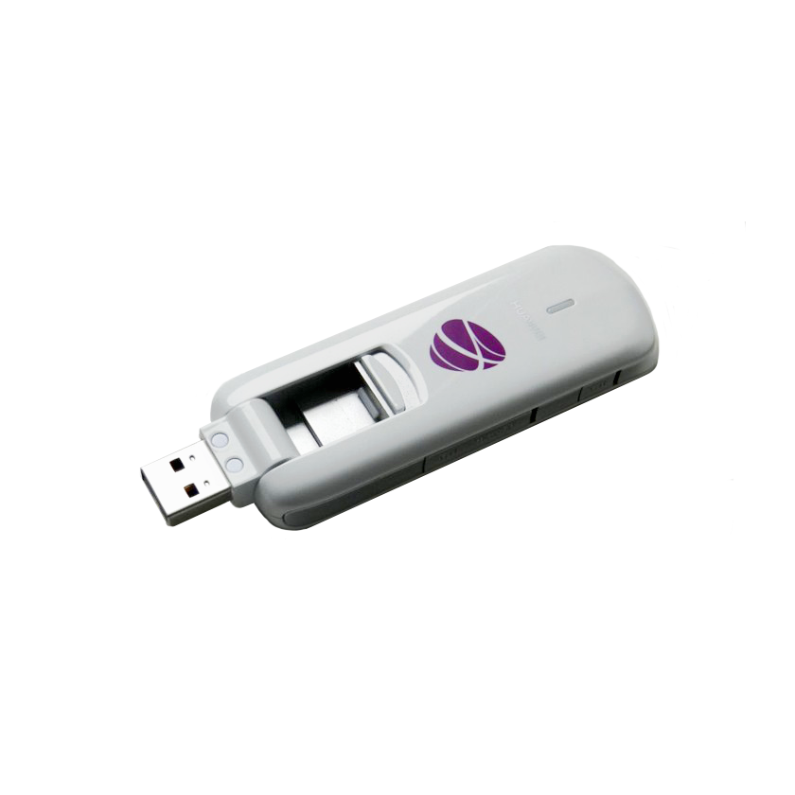
Security – Attack Type 3 (MitM)
Attack Situation:
A MitM device is added between the legitimate device and the supervised switch
The MitM device is passing all the data through an external entity using a 4G/LTE dongle
The traffic can be 100% intercepted
Credentials and cookies can be stolen
The traffic (and printed documents in this case) can be manipulated
  Switch S1
25
D
SEPIO | Zero Trust Hardware Access
39
Notes:
38

Slide 39
Security – Attack Type 3 (MitM)
Attack Detection:
A MitM device is added between the legitimate device and the supervised switch
Sepio sees MAC address and other logical parameters of the Printer
Sepio sees the Raspberry Pi DNA that is different than the expected DNA of the Printer
Sepio shows the Asset as the printer
Sepio reports a DNA Anomaly risk
  Switch S1
25
D
SEPIO | Zero Trust Hardware Access
40
Notes:
39

Slide 40
See What You’ve Been Missing.
Sepio helps organizations discover, verify, validate, and enforce trust at the hardware layer — before unknown devices become business risk.
Zero Trust Hardware Access
SEPIO | Zero Trust Hardware Access
24

