Slide 1
Mitigating Cyber Physical
Systems Risks
May 24

Slide 2
Questions our OT customers ask themselves -
Are all my assets listed?
Where are my assets located?
Are there any vulnerable assets that put us at risk?
Are my assets verified, and can I trust them?
Where are my regulatory compliance gaps?

Slide 3
Are all my assets listed?
Sepio provides a complete asset inventory of whatever is connected – internal components HW BOM, USB peripherals, wired and wireless Ethernet connected devices.
Easily integrated with CMDB solutions (e.g., ServiceNow).

Slide 4
Where are my assets located?
Sepio provides asset location information based on their specific network switch, USB port location or slot within the endpoint.

Slide 5
Are there any vulnerable assets that put us at risk?
Sepio’s embedded, regularly updated, known-to-be-vulnerable OSINT database provides an instant indication when an asset that might compromise the organization is connected.

Slide 6
Are my assets verified and can I trust them?
Sepio’s Zero Trust Hardware Access approach, where we validate the true identity of hardware assets before they can be trusted and granted access to the enterprise's resources, provides protection against spoofing or tapping devices.

Slide 7
Where are my regulatory compliance gaps?
Sepio’s granular ruleset-based policies ensure that regulatory compliance gaps are easily detected and reported.

Slide 8
“Nearly three-quarters (73%) admit that they only have strong awareness of less than 80% of all assets”
Seeing half of the picture
is not enough!
Source: ESG ,April 2023

Slide 9
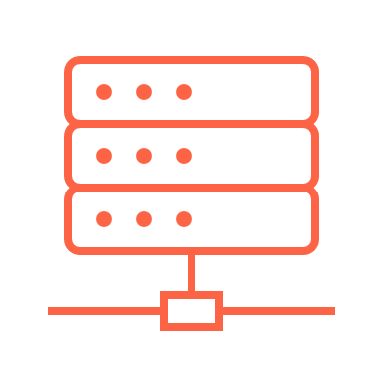
CPS Visibility Challenges
Active scanning → Potential impact on system responsiveness and availability.
Passive probing → Poor visibility (50%-80%) due to encrypted traffic.
Dormant assets→ Become “invisible” – MAC’less
Notes:
CPS are not compatible with traditional security tools as legacy solutions are not suitable for OT and IoT.
As CPS interact with the physical world, any disruption can have physical consequences, such as medical devices becoming inoperable, transport systems getting shut down, electricity going off etc..
OT processes interlinked with IT processes
To manipulate the control system — either through access to and utilization of HMI, replacement of control logic, or manipulation of industrial control protocols — first requires access to the industrial control network where target controllers are deployed. In a properly designed environment, this limits the potential vectors that an adversary can utilize in the initial attack phase:
1. The Network By first breaching business network(s), or utilizing remote access paths, adversaries require initial network penetration using traditional network attack techniques before pivoting into lower levels of the industrial networkOnce inside the industrial environment, adversaries can establish remote access to C2 servers, enabling cyber-physical attack phases.
2. Removable Media A common method of transferring data and files into and out of an industrial control environment is via removable media such as USB thumb drives. Attacks leveraging removable media can bypass network security controls, making it a popular attack vector against isolated OT systems.
3. The Supply Chain Both the hardware and software supply chain represent potential vectors into industrial networks. Hardware supplies are physically carried in past network defenses and could include devices that have been tampered with the intent of establishing covert networks for C2 or other malicious purposes. Several USB attack platforms could be introduced via the hardware supply chain, disguised as other legitimate devices (please refer to the Honeywell USB Hardware Attack Platforms Report).

Slide 10
Current Mean-Time-To-Value Challenges
Extensive use of human resources
Complexity due to additional sensors
Cumbersome network configuration

Slide 11
CPS Security challenges
Building a complete asset inventory
Enforcing granular security controls
Fulfilling regulatory compliance
Avoiding performance degradation

Slide 12
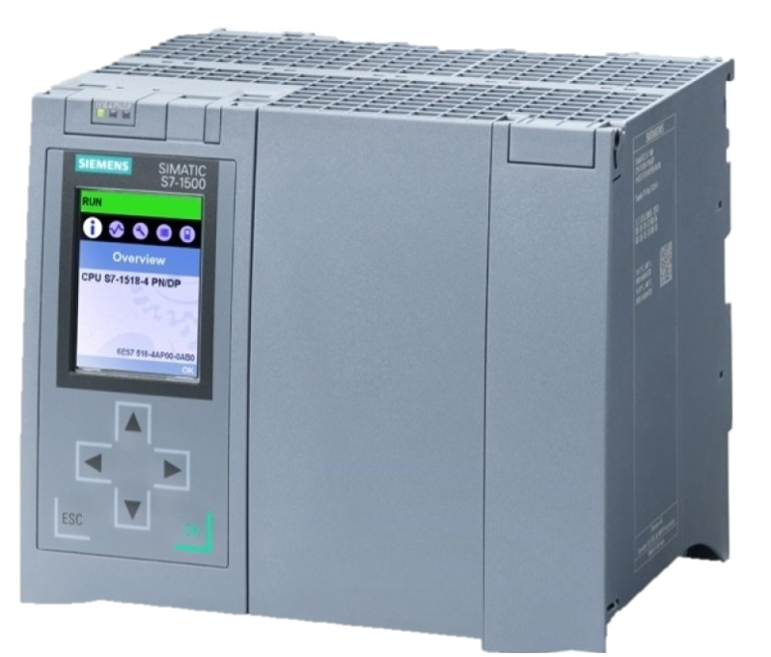
Friend or Foe?
Notes:
Two scenarios – same asset – one is authentic the other is rogue?
How would your existing solution see them?

Slide 13
Same MAC
00-1c-06-00-bc-37
00-1c-06-00-bc-37
Notes:
Both assets report and respond to ARP and other discovery protocols with the same L2 MAC address

Slide 14
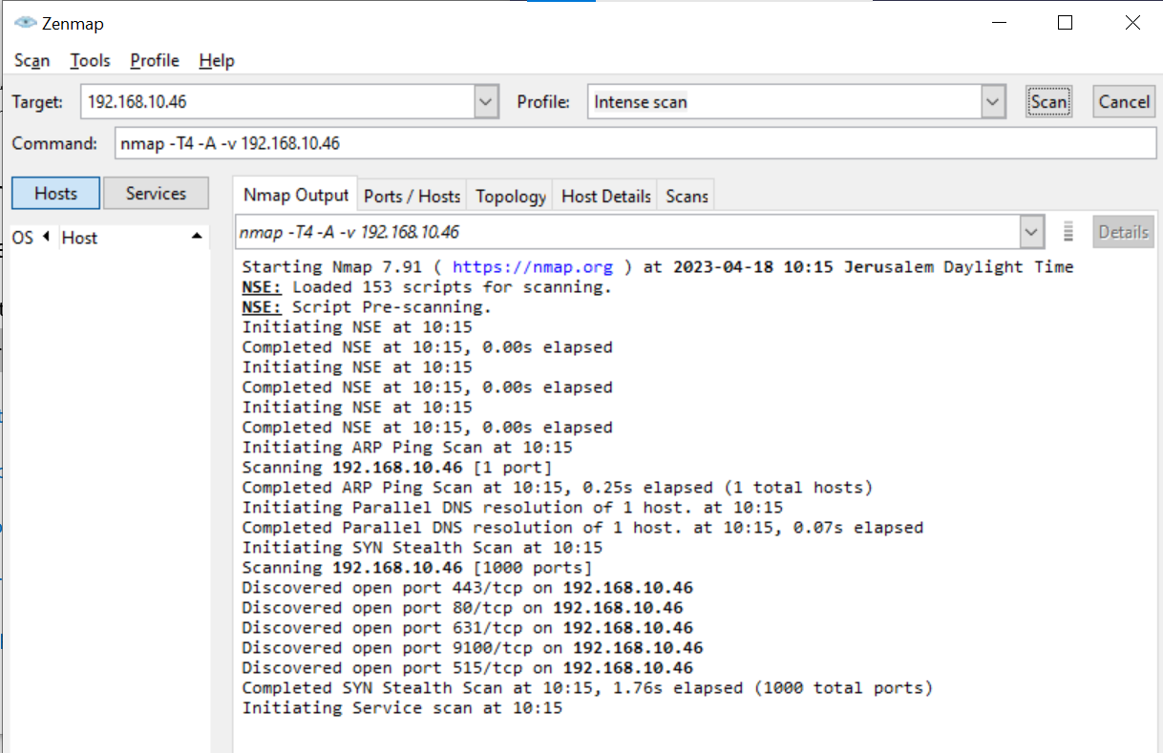
Same Ports
Notes:
You run NMAP or other port scanning solutions, both assets show an identical port mapping.

Slide 15
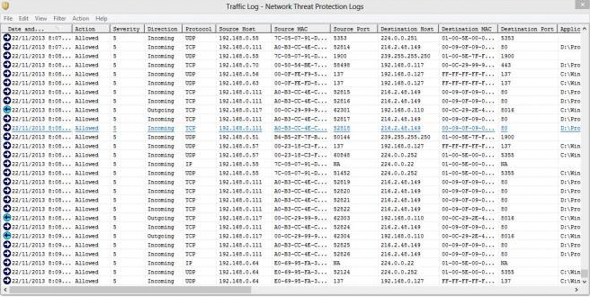
Same Traffic
Notes:
You run passive network probing – both assets behave the same way, but are they the same?

Slide 16
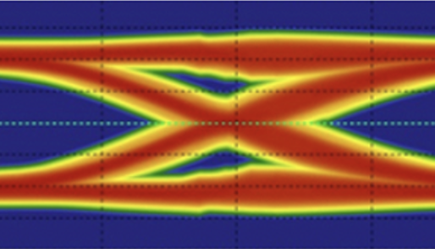
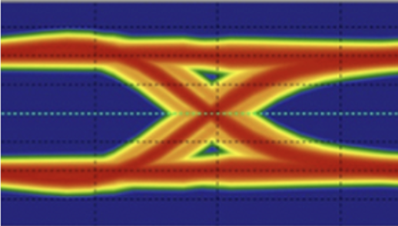
Different Asset DNA !
Notes:
BINGO! You can only tell them apart based on their physical layer characteristic – no MAC address, no port mapping or traffic , not of them can detect what is actually lurking in your network.

Slide 17
Sepio’s unique approach

Slide 18
Harnessing new data source
getting to the true source of asset risk without traffic monitoring
Create an Asset DNA
Risk assessment
Asset mapping
Notes:
Asset DNA
Sepio reveals the true identity of an asset based on physical layer properties that cannot be hidden or manipulated. Untainted by misleading profile perceptions and erroneous behavioral assumptions, Sepio is providing you with reliable, accurate visibility.
Risk assessing
Using patented algorithms and advanced machine learning models, Sepio calculator risk by evaluating each asset’s DNA, predicting its physical pattern, and analyzing how greatly it differs from the observed pattern.
Asset mapping
Sepio collects and analyzes anonymized data from customers across all industries, (200M+ data entries) and learns from local data on each installation, so the machine learning models and algorithms are continuously updated, resulting in an extremely low false positive rate.

Slide 19
How do we do it?
Asset DNA

Slide 20
Notes:
Sepio reveals the objective, true identity of an asset based on its physical layer properties, such as voltage, latency, and PoE. These properties cannot be hidden or manipulated. By harnessing the physical layer data source, Sepio is untainted by misleading profile perceptions and erroneous behavioral assumptions, providing customers reliable and accurate visibility.

Slide 21
Asset DNA provides a single source of truth, focusing on EXISTENCE – rather than ACTIVITY.
With our patented technology, we now harness a new data source – physical layer to accurately identify and classify your assets.

Slide 22
Passive network probing is an IT/OT nightmare
Sepio’s trafficless solution avoids cumbersome deployments and privacy issues, vertical, type and protocol indifferent, at any scale, without effecting the network performance.

Slide 23
XDR/EDR
device control
still has blind spots
Sepio’s enhanced visibility provides unmatched rogue device mitigation, while supporting USB entitlement at scale.

Slide 24
Go beyond legacy
NAC solutions
Embrace Sepio’s Zero Trust Hardware Access (ZTHA) to augment your ZTNA initiatives across all your assets (IT/IoT/OT).
Establish trust, validate assets, enforce regulatory compliance with a single low TCO solution.

Slide 25
Sepio’s proven value for CPS

Slide 26
Complete OT/IT/IoT asset visibility
OT asset protection
Maintaining operational continuity
Easier risk management compliance
Mitigate known threats
Critical Infrastructure
Business
Benefits
Sepio has an innovative and robust solution that identifies a type of threats that were difficult to identify otherwise
R&D Engineer
Leading Global Energy and Utilities Provider

Slide 27
Who benefits from our data?
SIEM/SOAR
ITAM & CMDB
Instant alerts when unwanted or rogue devices are connected, eliminating unnecessary noise
Contextual information, i.e. asset location, expedites response time to prevent crises
Publicly recognized asset vulnerability module (OSINT and proprietary) for an immediate mitigation
Reduce complexity with a consolidated source of asset visibility across all environments
Reduce hardware clutter
Ensure operational efficiency of assets
Security team
CAASM
Understand what needs attention with actionable data
Enforce organization policies and establish trust at the asset level
Greater ROI by radically improving the efficacy of existing tools
Augment existing data sources
Validate security controls
Remediate issues

Slide 28
Architecture and Deployment aspects

Slide 29
Network Infrastructure
CLOUD
Ethernet Switches
Wi-Fi WLCs+APs
Discover & Mitigate
All connected assets Asset vulnerabilities Shadow IT
Spoofed assets
Big Data, AI and Machine Learning
SSH polling the infrastructure (read-only), physical layer information (no traffic monitoring)
Physical Layer Interfaces
Open REST APIs
Endpoints

Slide 30
Sepio agent deployment options
Fixed agent (including VDI support)
Session based
Dissolvable agent

Slide 31
Typical Customer Journey
Workshop with extended team
Identify key use cases – endpoint or network
PoV – installs in hours; standard duration up to 2 weeks
Develop deployment and integration plan
Present business case for approval

Slide 32
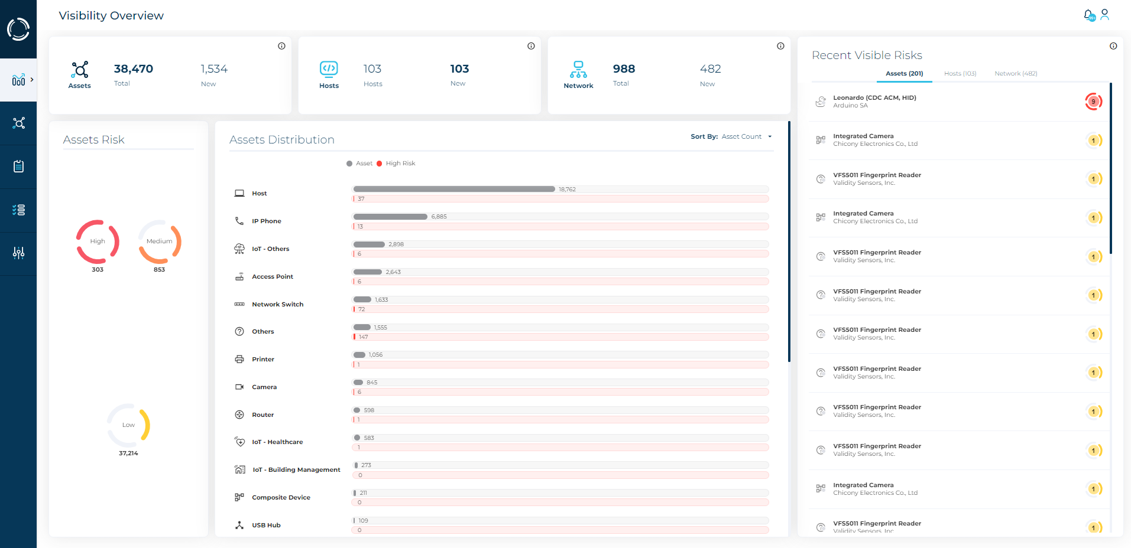
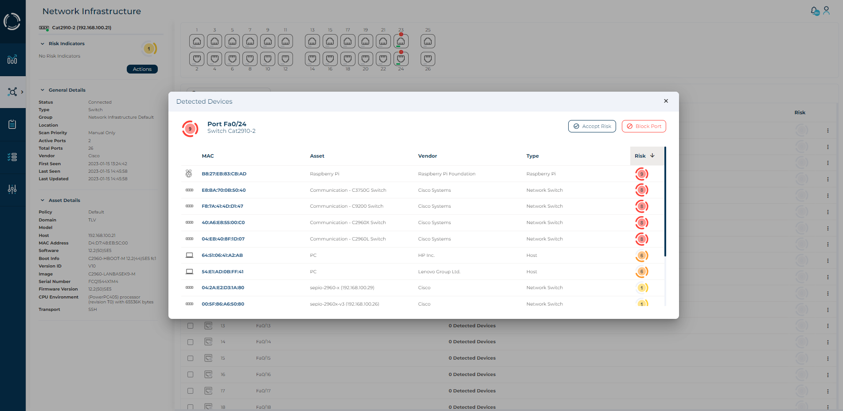
Deployment process
Install the software only Sepio Platform using preferred method
Using the browser UI, import a license
Import switches/WLC to Sepio
Deploy Sepio agents
Complete integration in upstream systems
Cloud, virtual, on-prem or via Azure marketplace
Can be done manually by providing IP-SSH username – SSH password
Can be done by importing CSV file
Supports Windows/RHEL/Debian
Can be installed manually or using a distribution tool

Slide 33
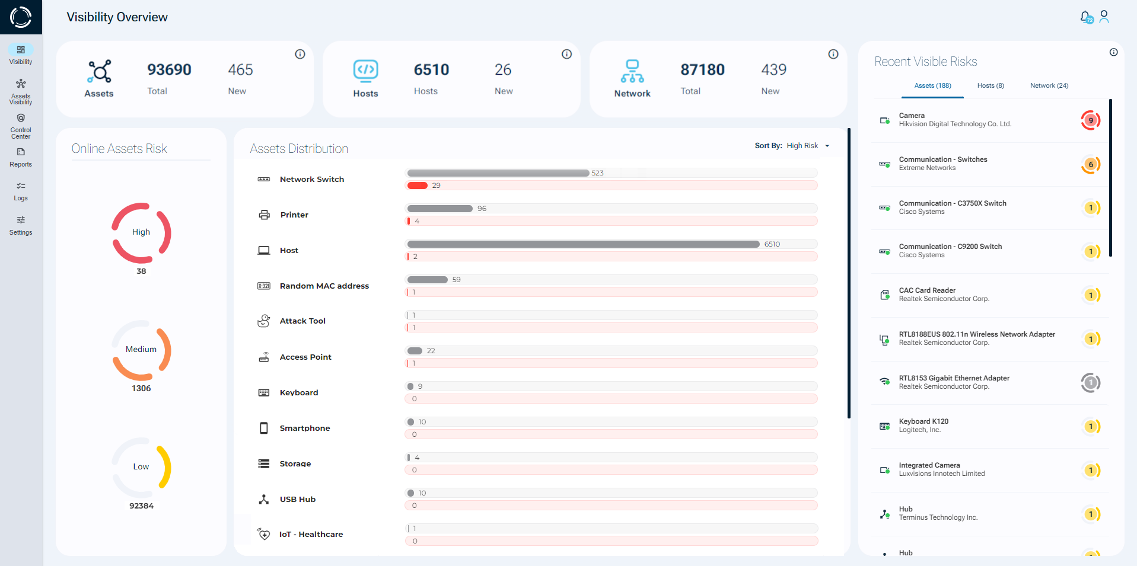
Sepio’s Asset Risk Management solution
Notes:
Formally launched our newest release and this is a sneak preview of our updated dashboard. Talk to us to learn more about the full solution feature set.

Slide 34
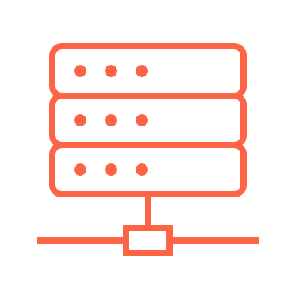
See what you’ve been missing

