Slide 1
Mitigating Cyber Physical
Systems Risks in Healthcare
Jan 25

Slide 2
Questions our healthcare customers ask themselves -
Are all my assets listed?
Where are my assets located?
Are my assets verified, and can I trust them?
Are there any vulnerable assets that put us at risk?
Where are my regulatory compliance gaps?

Slide 3
Case study

Slide 4
Baptist deployment highlights
More than 27,500 hosts and 544 network switches
More than 635K connected assets
Mix of new and legacy networking infrastructure
Periodic reporting
Attack surface reduction

Slide 5
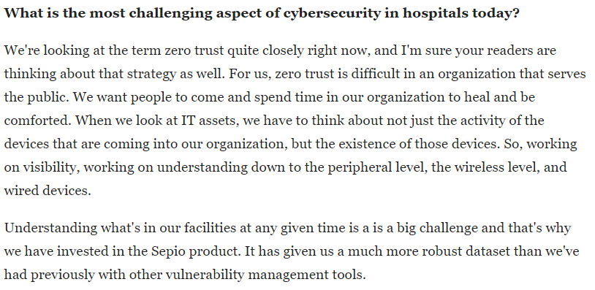

Slide 6
“Nearly three-quarters (73%) admit that they only have strong awareness of less than 80% of all assets”
Seeing half of the picture
is not enough!
Source: ESG ,April 2023

Slide 7
CPS Visibility Challenges
Active scanning → Potential impact on system responsiveness and availability.
Passive probing → Poor visibility (50%-80%) due to encrypted traffic.
Dormant assets→ Become “invisible” – MAC’less
Notes:
CPS are not compatible with traditional security tools as legacy solutions are not suitable for OT and IoT.
As CPS interact with the physical world, any disruption can have physical consequences, such as medical devices becoming inoperable, transport systems getting shut down, electricity going off etc..
OT processes interlinked with IT processes
To manipulate the control system — either through access to and utilization of HMI, replacement of control logic, or manipulation of industrial control protocols — first requires access to the industrial control network where target controllers are deployed. In a properly designed environment, this limits the potential vectors that an adversary can utilize in the initial attack phase:
1. The Network By first breaching business network(s), or utilizing remote access paths, adversaries require initial network penetration using traditional network attack techniques before pivoting into lower levels of the industrial networkOnce inside the industrial environment, adversaries can establish remote access to C2 servers, enabling cyber-physical attack phases.
2. Removable Media A common method of transferring data and files into and out of an industrial control environment is via removable media such as USB thumb drives. Attacks leveraging removable media can bypass network security controls, making it a popular attack vector against isolated OT systems.
3. The Supply Chain Both the hardware and software supply chain represent potential vectors into industrial networks. Hardware supplies are physically carried in past network defenses and could include devices that have been tampered with the intent of establishing covert networks for C2 or other malicious purposes. Several USB attack platforms could be introduced via the hardware supply chain, disguised as other legitimate devices (please refer to the Honeywell USB Hardware Attack Platforms Report).

Slide 8
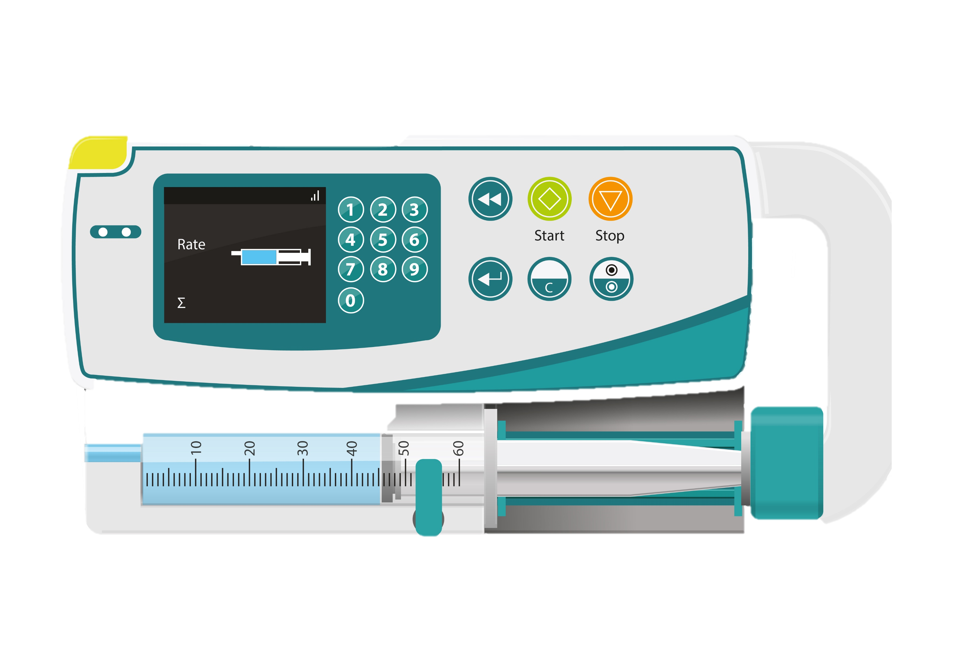
Friend or Foe?
Notes:
Two scenarios – same asset – one is authentic the other is rogue?
How would your existing solution see them?

Slide 9
Same MAC
MAC:00D085045802
MAC:00D085045802
Notes:
Both assets report and respond to ARP and other discovery protocols with the same L2 MAC address

Slide 10
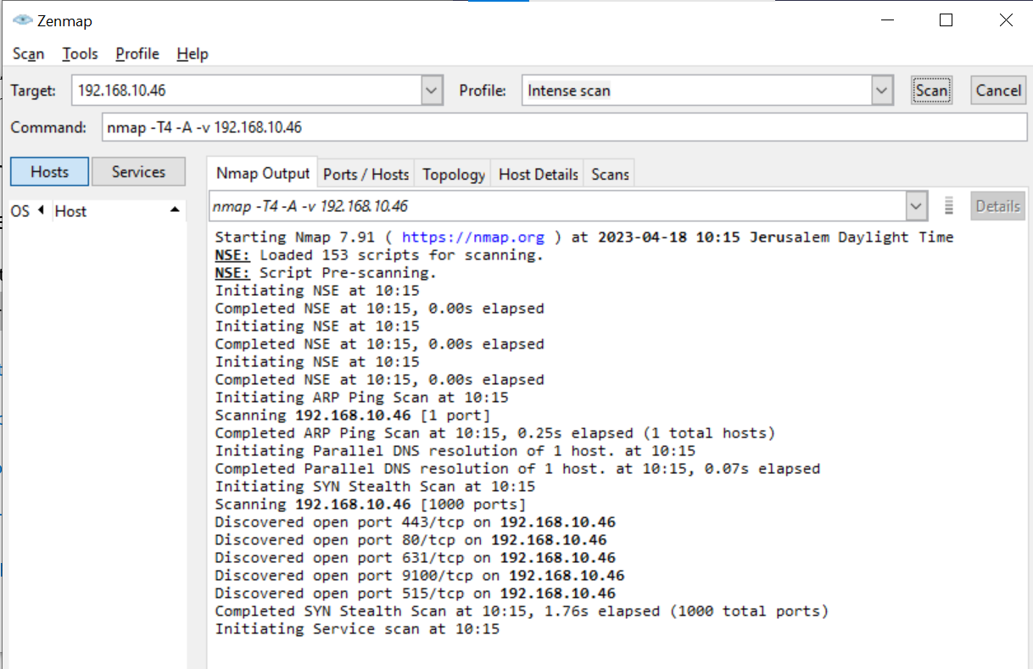
Same Ports
Notes:
You run NMAP or other port scanning solutions, both assets show an identical port mapping.

Slide 11
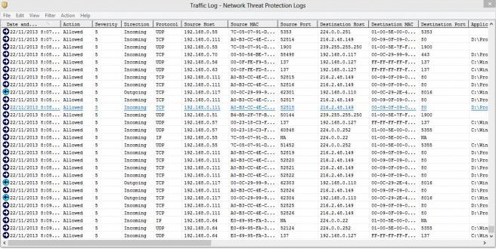
Same Traffic
Notes:
You run passive network probing – both assets behave the same way, but are they the same?

Slide 12
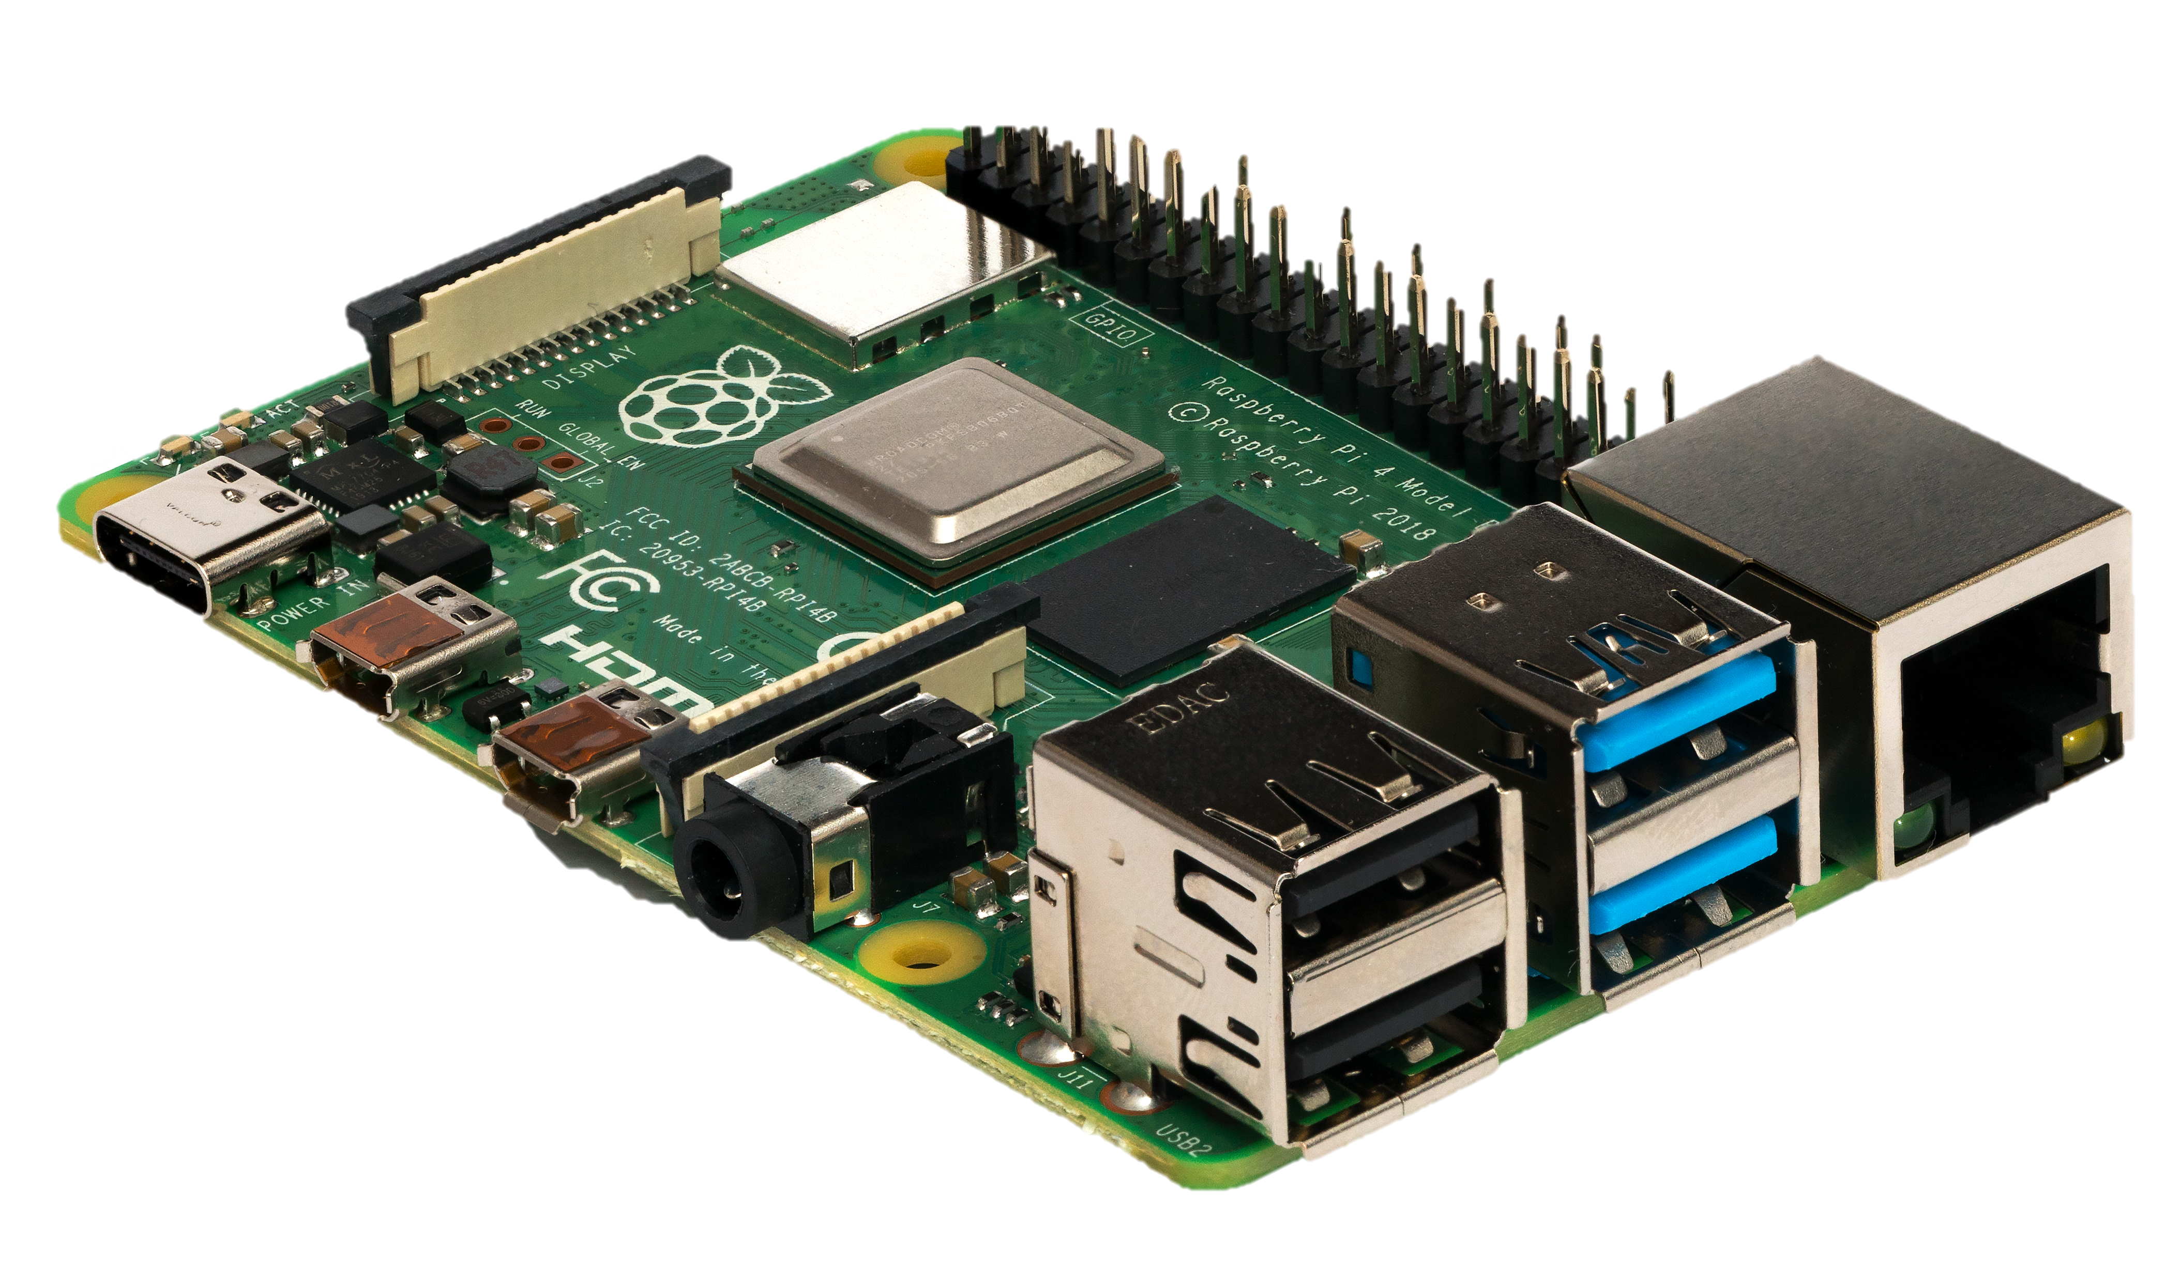
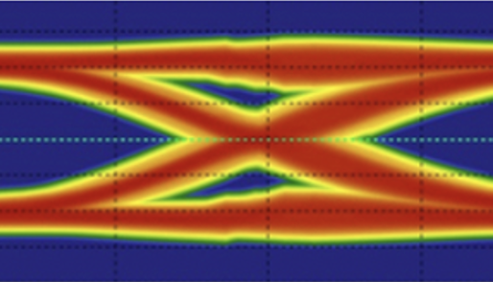
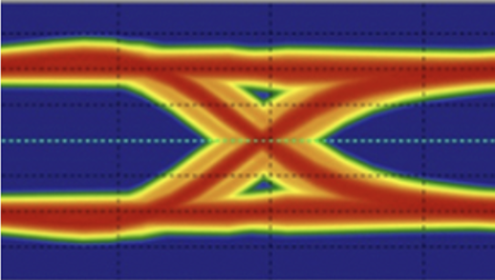
Different Asset DNA !
Notes:
BINGO! You can only tell them apart based on their physical layer characteristic – no MAC address, no port mapping or traffic , not of them can detect what is actually lurking in your network.

Slide 13
How do we do it?
Asset DNA

Slide 14
Notes:
Sepio reveals the objective, true identity of an asset based on its physical layer properties, such as voltage, latency, and PoE. These properties cannot be hidden or manipulated. By harnessing the physical layer data source, Sepio is untainted by misleading profile perceptions and erroneous behavioral assumptions, providing customers reliable and accurate visibility.

Slide 15
Asset DNA provides a single source of truth, focusing on EXISTENCE – rather than ACTIVITY.
With our patented technology, we now harness a new trafficless data source – physical layer to accurately identify and classify your assets.

Slide 16
Healthcare
Business
Benefits
Complete asset inventory
Ensure operational efficiency of medical assets
Maintain delivery of healthcare services
Uphold patient safety
Budget and resource planning
Support regulatory compliance (HIPAA, GDPR)
Prevent breaches
We’re bringing a new set of information to our asset inventories and it’s helping us plan the lifecycle of assets
Michael Erickson, CISO,
Baptist Health

Slide 17
Who benefits from our data?
SIEM/SOAR
ITAM & CMDB
Instant alerts when unwanted or rogue devices are connected, eliminating unnecessary noise
Contextual information, i.e. asset location, expedites response time to prevent crises
Publicly recognized asset vulnerability module (OSINT and proprietary) for an immediate mitigation
Reduce complexity with a consolidated source of asset visibility across all environments
Reduce hardware clutter
Ensure operational efficiency of assets
Security team
CAASM
Understand what needs attention with actionable data
Enforce organization policies and establish trust at the asset level
Greater ROI by radically improving the efficacy of existing tools
Augment existing data sources
Validate security controls
Remediate issues

Slide 18
See what you’ve been missing

