Slide 1



For Financial Services
Overview of Sepio’s Asset Risk Management Platform
July 23

Slide 2















Hardware assets pose major security concerns
1
Visibility and validation of all Hardware Assets including:
Peripheral devices
(MAC-less devices)
Hardware BOM
2
Hardware Zero Trust Control access to the enterprise through granular policy enforcement & hardware identity validation
3
Rogue Device Mitigation (RDM) of spoofed, manipulated devices, and hidden implants
4
Detection of Hardware Manipulation
within the supply chain

Slide 3
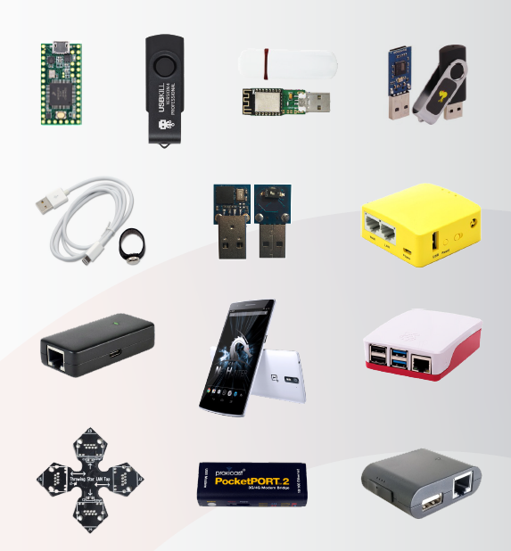

Hardware attack tools are gaining popularity
Every physical asset is an exposure
Uncontrolled assets are an entry point for malware/ransomware payloads
Uncontrolled assets are an exit door for sensitive data leakage
Uncontrolled asset provide a permanent foothold for threat actors in the organization: MiTM, Data manipulation etc.

Slide 4
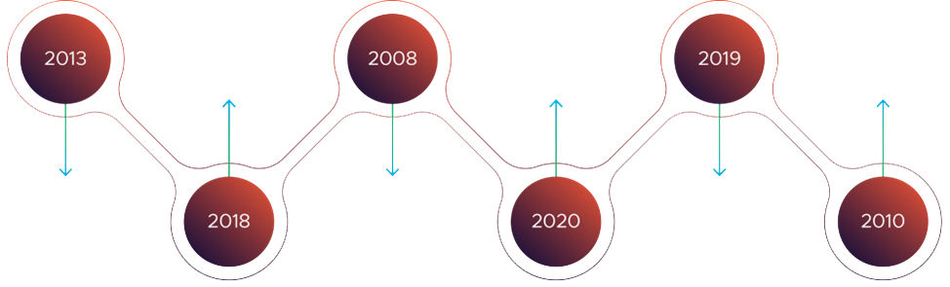





Is it really happening? Yes!
Why? Attackers are pursing the path-of-least-resistance
Nuclear Facility Damaged in USB Drop Attack
8 Eastern European Banks Breached
2008
2013
FIN7 group USB attack
Raspberry Pi used to steal restricted NASA data
US Military USB attack
2010
Santander Bank London
2018
2020
Notes:
Two scenarios – same asset – one is authentic the other is rogue?
How would your existing solution see them?

Slide 5
Use cases

Slide 6
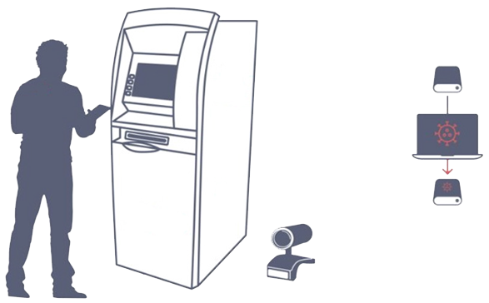






ATM use case: FiXS The new ATM malware in LATAM
Ploutus-I is installed in a whitelisted folder And added to the registry run key
2
CPU
Core
Mule opens soft zone to extract Hard Disk
3
Hard Disk infected
is connected back
1
Dispenser
/Recycler
Mule connects external keyboard disguised as a webcam
Sepio detects the disguised keyboard & blocks it at connection. Stops the execution before it starts.
5
Mule enters combination of F keys to start dispensing
4
Ploutus-I
6
Ploutus-I
Validates activation code entered with the keyboard
spawn GG.exe which controls XFS Middleware

Slide 7


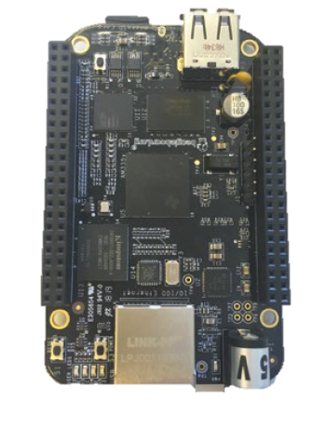
USB use case: Bypassing biometric security measures
Palm vein scanner connected over USB
High privilege user endpoint
Beaglebone low-cost board running USB Proxy MiTM.

Slide 8
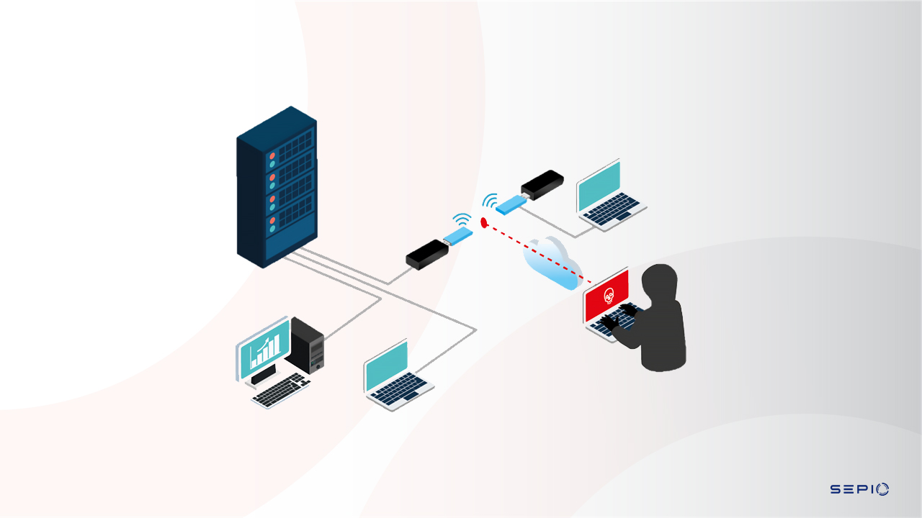
Network use case: MiTM transparent attack
PocketPort 2 in VCM mode over cellular
First entry point
Attacker connected to the PP2 switchboard

Slide 9
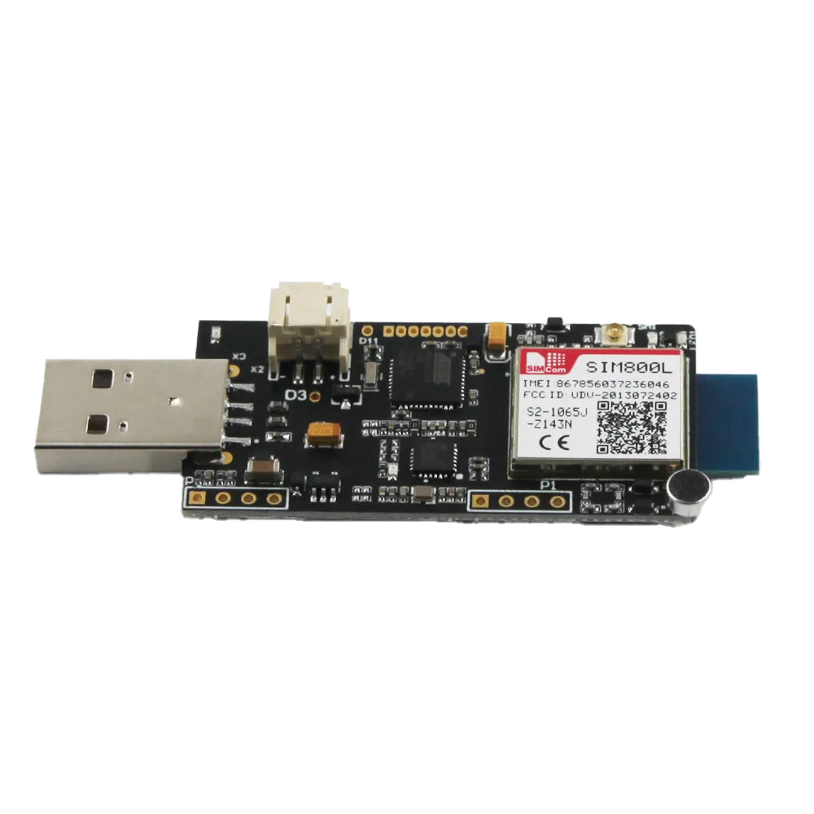



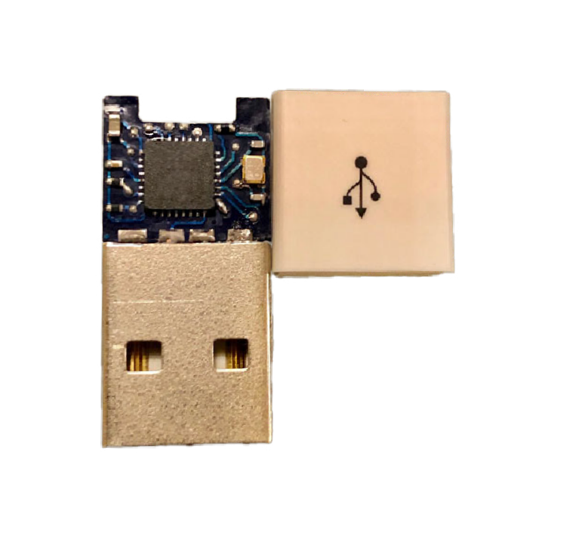
Peripheral asset attacks
Way In
Way Out
0x8A,0xC6,0x22,...
http://URL...
cmd /c netsh wlan show profiles “+NetName+”...
Depending on attacker’s “style” and prior knowledge of the target, they will either:
Use HID emulation for binary payload
“Send” the target PC to a pre-known/prepared web URL to download the payload
Act as a Network Interface and inject the payload into the PC
Use USB Proxy MiTM attacks
Exfiltrate the data directly to the attack tool
Use an integrated Wi-Fi to remotely extract
Connect to the internet and exfiltrate the data “invisibly” – such as adding comments on youtube
Use continuous and invisible remote shell into corporate PCs

Slide 10

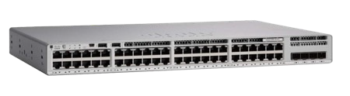


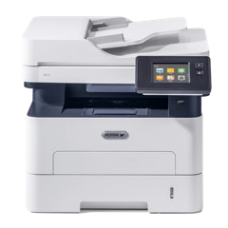
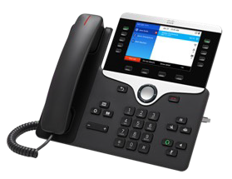

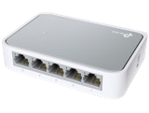

Network asset - MiTM & 802.1x bypassing
MiTM rogue device
Unmanaged switch & uncontrolled (MiTM) hardware are completely invisible to NAC and IDS/IPS
Any device that is connected poses a risk-
  Spoof to be a legitimate device and send traffic into the network
  Intercept/manipulate traffic between a legitimate asset and the network
  Invisibly infect/attack a legitimate asset without being flagged
  Create as invisible and continuous foothold in the infrastructure
Laptop
Unmanaged switch

Slide 11

Questions our customers ask themselves
Do I see all my assets?
Are there any vulnerable assets?
Are the assets, what they say they are?
Is there something connected in the middle?
Do I have regulatory compliance gaps?

Slide 12
Existing technologies blind spots

Slide 13
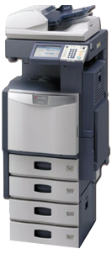
Friend or Foe?
Notes:
Two scenarios – same asset – one is authentic the other is rogue?
How would your existing solution see them?

Slide 14
Same MAC
MAC:00D085045802
MAC:00D085045802
Notes:
Both assets report and respond to ARP and other discovery protocols with the same L2 MAC address

Slide 15
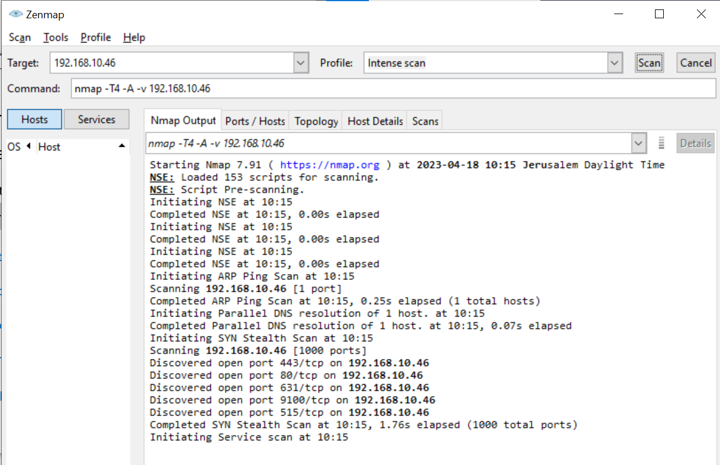
Same Ports
Notes:
You run NMAP or other port scanning solutions, both assets show an identical port mapping.

Slide 16
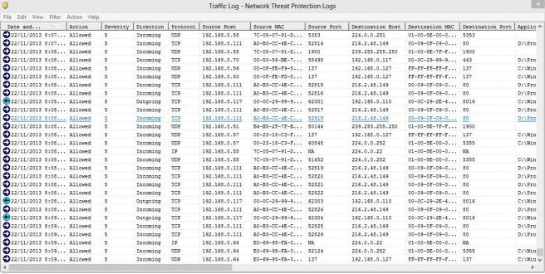
Same Traffic
Notes:
You run passive network probing – both assets behave the same way, but are they the same?

Slide 17
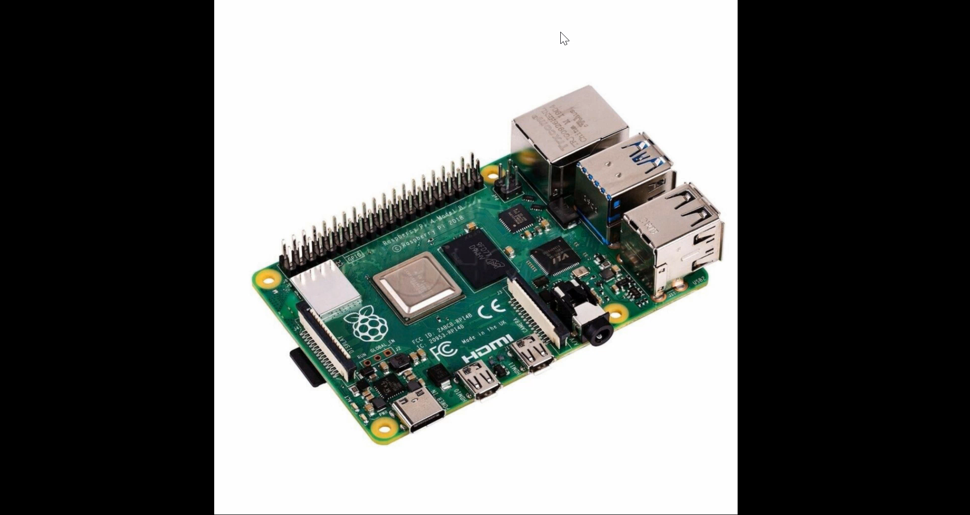


Different Asset DNA!
Notes:
BINGO! You can only tell them apart based on their physical layer characteristic – no MAC address, no port mapping or traffic , not of them can detect what is actually lurking in your network.

Slide 18

Passive network probing is an IT/OT nightmare
Sepio’s trafficless solution avoids cumbersome deployments and privacy issues, vertical, type and protocol indifferent, at any scale, without effecting the network performance.

Slide 19

XDR/EDR device control still has blind spots
Sepio’s enhanced visibility provides unmatched rogue device mitigation, while supporting USB entitlement at scale.

Slide 20

Go beyond legacy NAC solutions
Embrace Sepio’s Zero Trust Hardware Access (ZTHA) to augment your ZTNA initiatives across all your assets (IT/IoT/OT).
Establish trust, validate assets, enforce regulatory compliance with a single low TCO solution.

Slide 21
Sepio’s unique approach

Slide 22
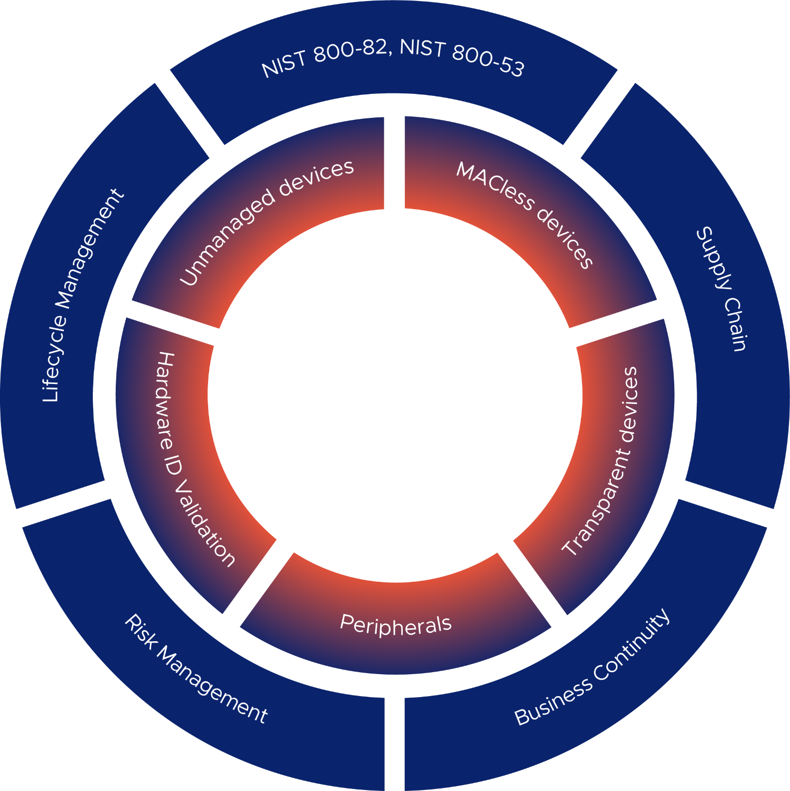


Sepio’s approach:
Identify and validate
Visibility and identity gaps
Business value
Notes:
Asset DNA
Sepio reveals the true identity of an asset based on physical layer properties that cannot be hidden or manipulated. Untainted by misleading profile perceptions and erroneous behavioral assumptions, Sepio is providing you with reliable, accurate visibility.
Risk assessing
Using patented algorithms and advanced machine learning models, Sepio calculator risk by evaluating each asset’s DNA, predicting its physical pattern, and analyzing how greatly it differs from the observed pattern.
Asset mapping
Sepio collects and analyzes anonymized data from customers across all industries, (200M+ data entries) and learns from local data on each installation, so the machine learning models and algorithms are continuously updated, resulting in an extremely low false positive rate.

Slide 23



Harnessing new data source.
Getting to the true source of asset risk without traffic monitoring
Create an Asset DNA
Risk assessment
Asset mapping
Notes:
Asset DNA
Sepio reveals the true identity of an asset based on physical layer properties that cannot be hidden or manipulated. Untainted by misleading profile perceptions and erroneous behavioral assumptions, Sepio is providing you with reliable, accurate visibility.
Risk assessing
Using patented algorithms and advanced machine learning models, Sepio calculator risk by evaluating each asset’s DNA, predicting its physical pattern, and analyzing how greatly it differs from the observed pattern.
Asset mapping
Sepio collects and analyzes anonymized data from customers across all industries, (200M+ data entries) and learns from local data on each installation, so the machine learning models and algorithms are continuously updated, resulting in an extremely low false positive rate.

Slide 24

How do we do it?
Asset DNA

Slide 25
Asset DNA provides a single source of truth, focusing on EXISTENCE – rather than ACTIVITY.
With our patented technology, we now harness a new data source – physical layer to accurately identify and classify your assets.

Slide 26

Introducing Asset DNA
Host
Network
Notes:
Sepio reveals the objective, true identity of an asset based on its physical layer properties, such as voltage, latency, and PoE. These properties cannot be hidden or manipulated. By harnessing the physical layer data source, Sepio is untainted by misleading profile perceptions and erroneous behavioral assumptions, providing customers reliable and accurate visibility.

Slide 27
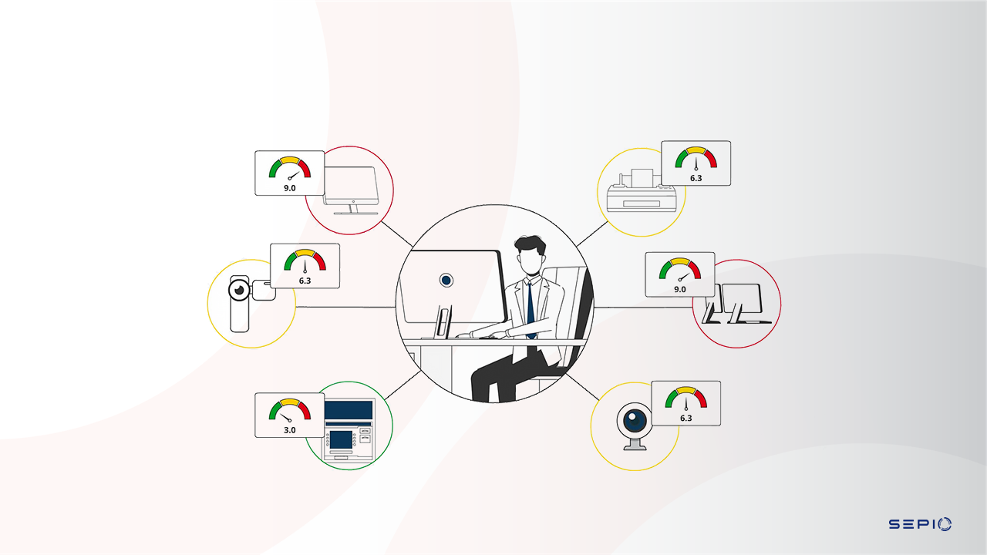
ARF – Risk Assessing
Notes:
Using patented algorithms and complex machine learning models, Sepio evaluates each asset’s DNA and predicts its behavioral pattern, analyzing how greatly it differs from the observed behavior pattern to calculate its risk.
Sepio collects and analyzes anonymized data from customers across all industries, (200M+ data entries) and learns from local data on each installation, so the machine learning models and algorithms are continuously updated, resulting in an extremely low false positive rate.

Slide 28
Sepio’s proven value for FIS

Slide 29



Finance Business
Benefits
Complete asset visibility
Mitigate rogue devices and supply chain risks.
Close NAC gaps and fortify micro segmentation
Support regulatory compliance
Budget and resource planning
Apply assets usage policy entitlement, at scale.
Sepio sheds light on items I couldn’t identify and now I can make better decisions; I can contextualize what a device is where I wouldn’t have had visibility otherwise.
Director of Network Architecture and Engineering,
Tier 1 Financial Institution

Slide 30
Who benefits from our data?
SIEM/SOAR
ITAM & CMDB
Instant alerts when unwanted or rogue devices are connected, eliminating unnecessary noise
Contextual information, i.e., asset location, expedites response time to prevent crises
Publicly recognized asset vulnerability module (OSINT and proprietary) for an immediate mitigation
Reduce complexity with a consolidated source of asset visibility across all environments
Reduce hardware clutter
Ensure operational efficiency of assets
Security team
CAASM
Understand what needs attention with actionable data
Enforce organization policies and establish trust at the asset level
Greater ROI by radically improving the efficacy of existing tools
Augment existing data sources
Validate security controls
Remediate issues

Slide 31
Architecture and Deployment aspects

Slide 32











Network Infrastructure
CLOUD
Ethernet Switches
Wi-Fi WLCs+APs
Discover & Mitigate
All connected assets Asset vulnerabilities Shadow IT
Spoofed assets
Big Data, AI and Machine Learning
SSH polling the infrastructure (read-only), physical layer information (no traffic monitoring)
Physical Layer Interfaces
Open REST APIs
Endpoints

Slide 33



Sepio agent deployment options
Fixed agent
Session based
Dissolvable agent

Slide 34

Typical Customer Journey
Workshop with extended team
Identify key use cases – endpoint or network
PoV – installs in hours; standard duration up to 2 weeks
Develop deployment and integration plan
Present business case for approval

Slide 35






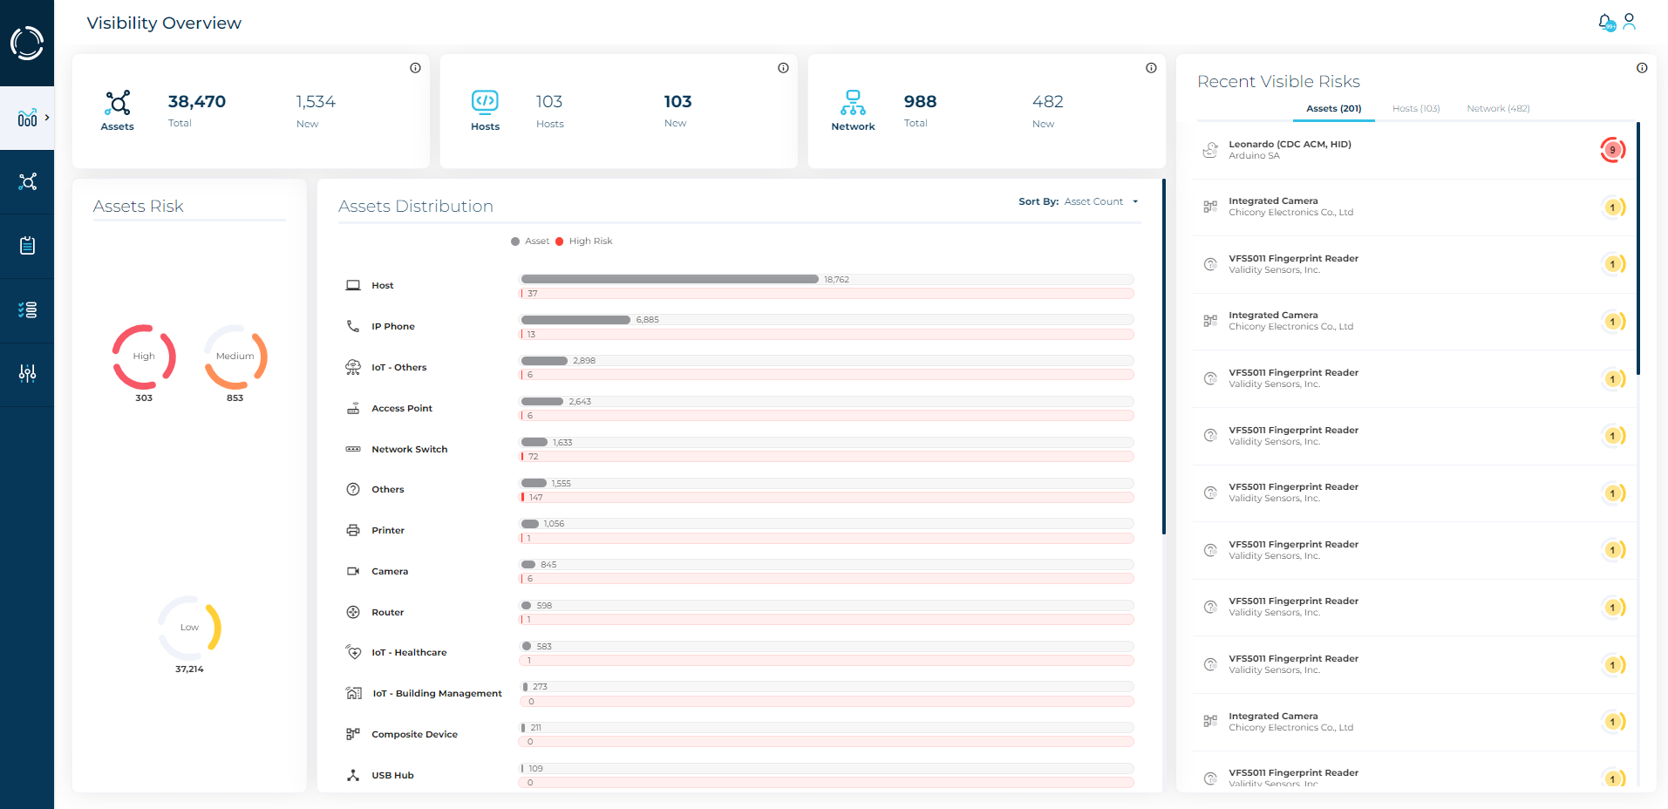
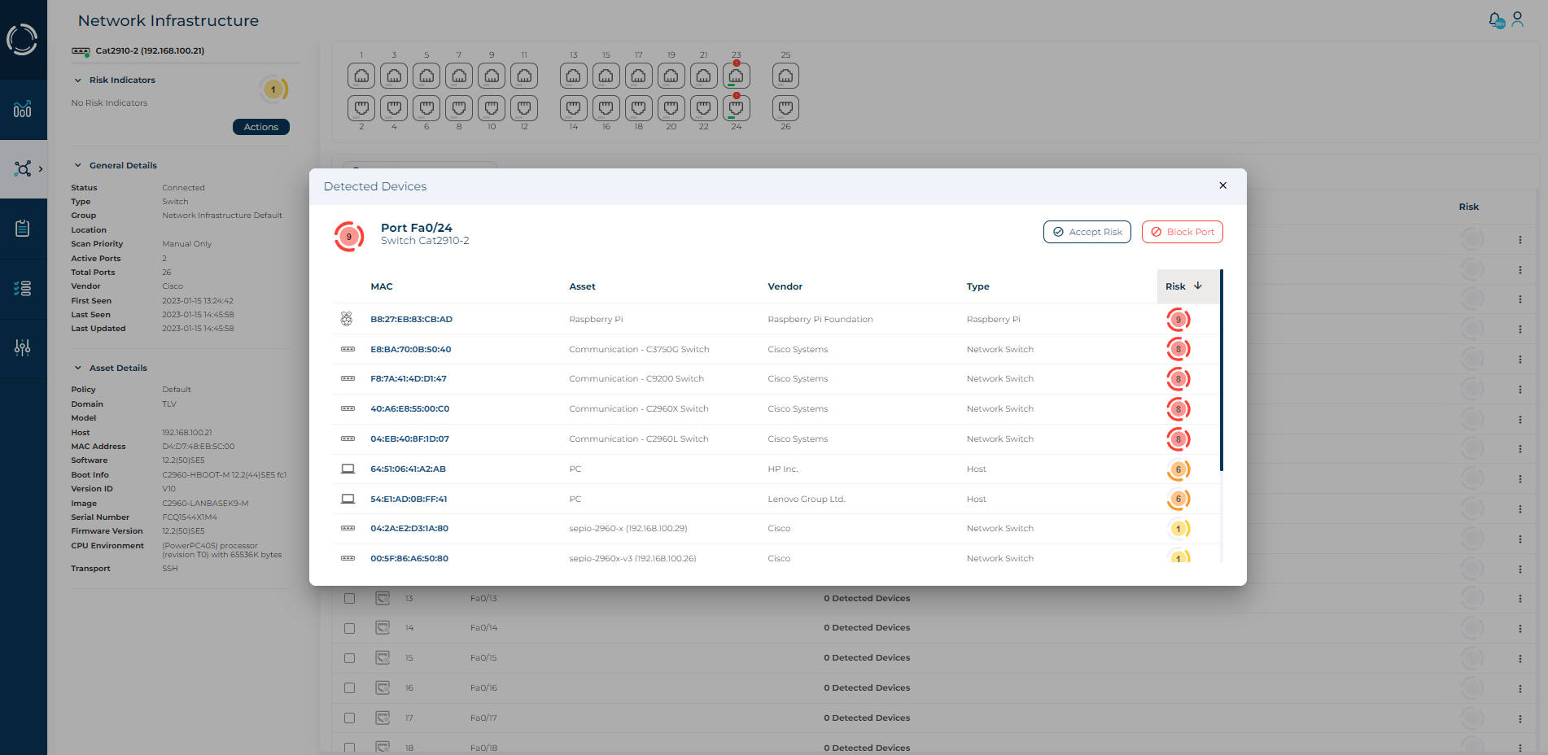
Deployment process
Install the software only Sepio Platform using preferred method
Using the browser UI, import a license
Import switches/WLC to Sepio
Deploy Sepio agents
Complete integration in upstream systems
Cloud, virtual, on-prem or via Azure marketplace
Can be done manually by providing IP-SSH username – SSH password
Can be done by importing CSV file
Supports Windows/RHEL/Debian
Can be installed manually or using a distribution tool

Slide 36
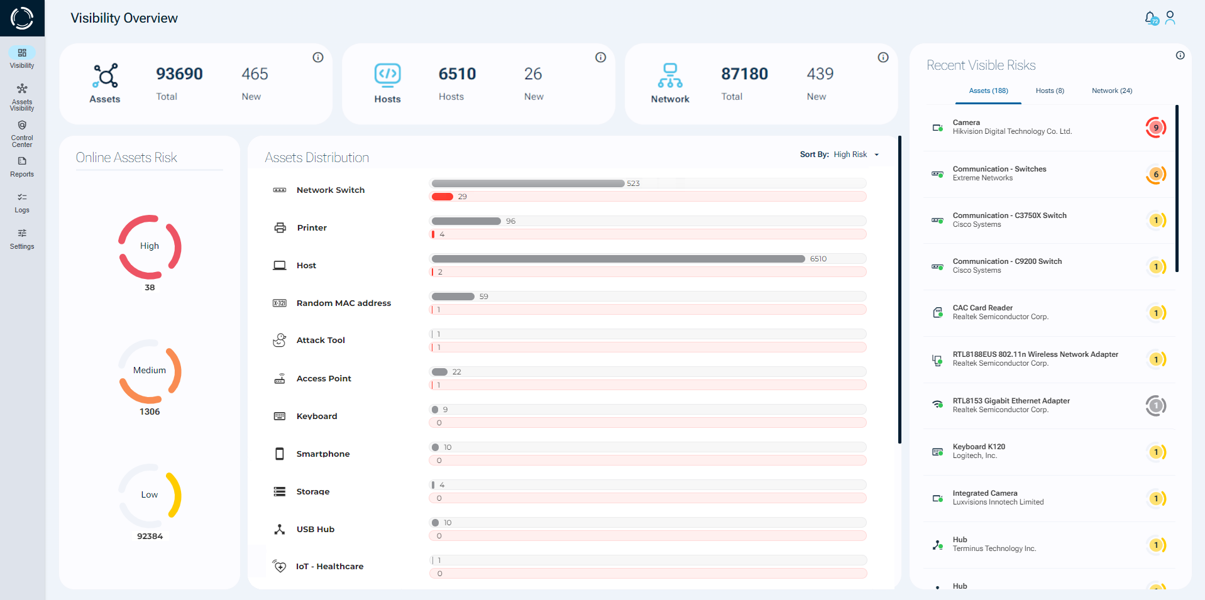
Sepio’s Asset Risk Management solution
Notes:
Formally launched our newest release and this is a sneak preview of our updated dashboard. Talk to us to learn more about the full solution feature set.

Slide 37













See what you’ve been missing

